Slide 1
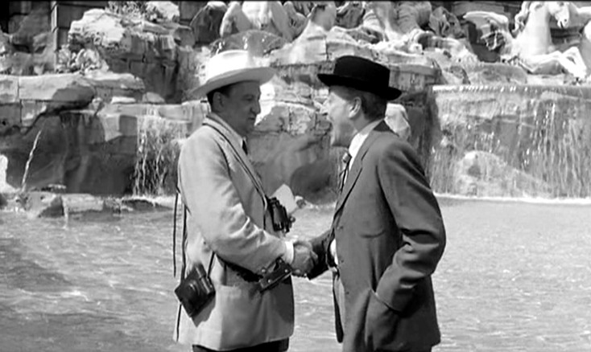
Social Engineering

Slide 2
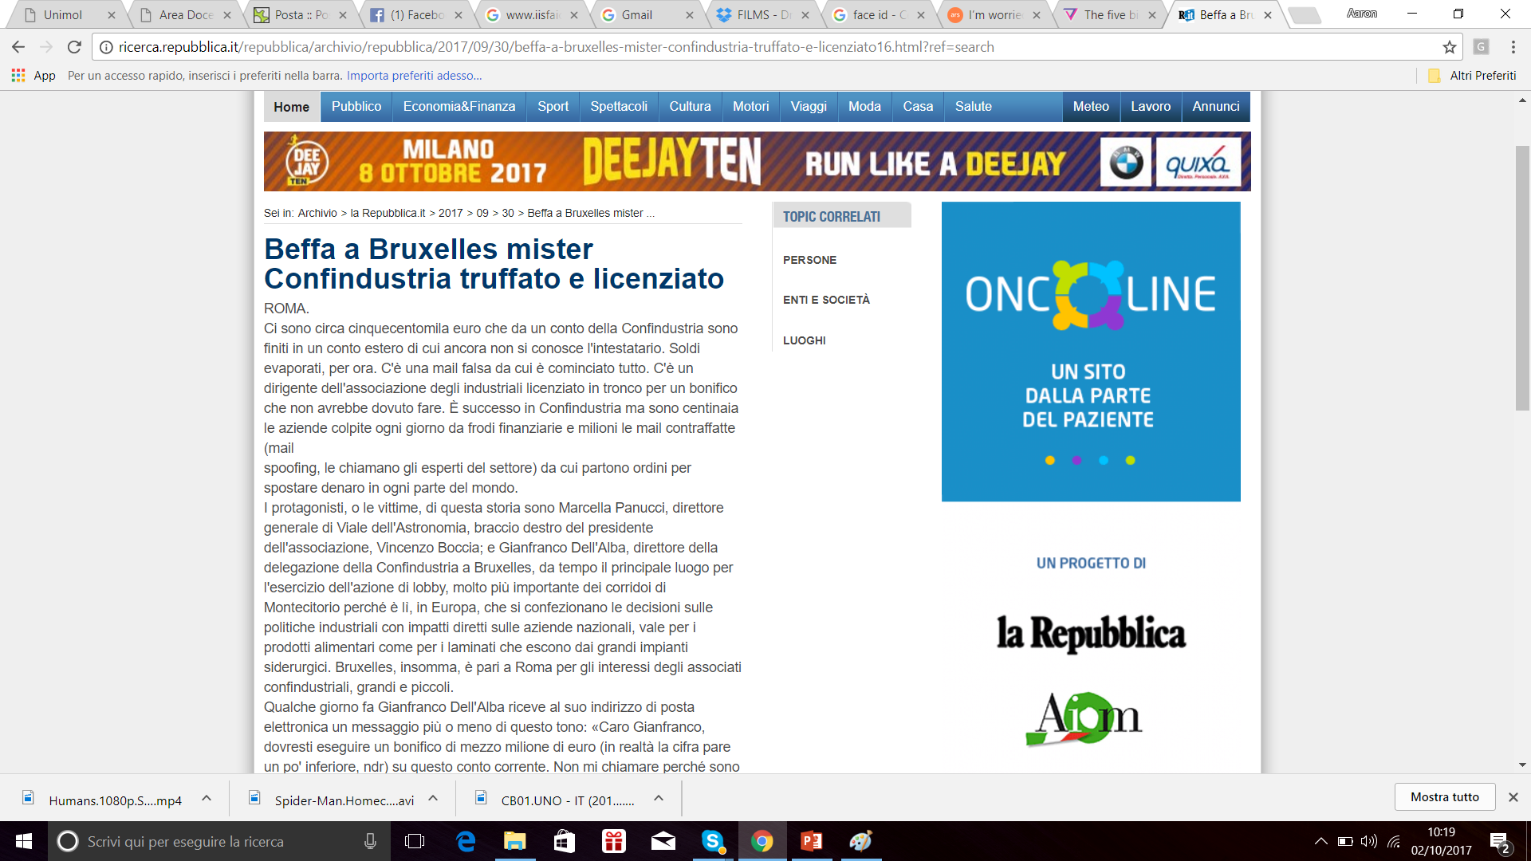

Slide 3
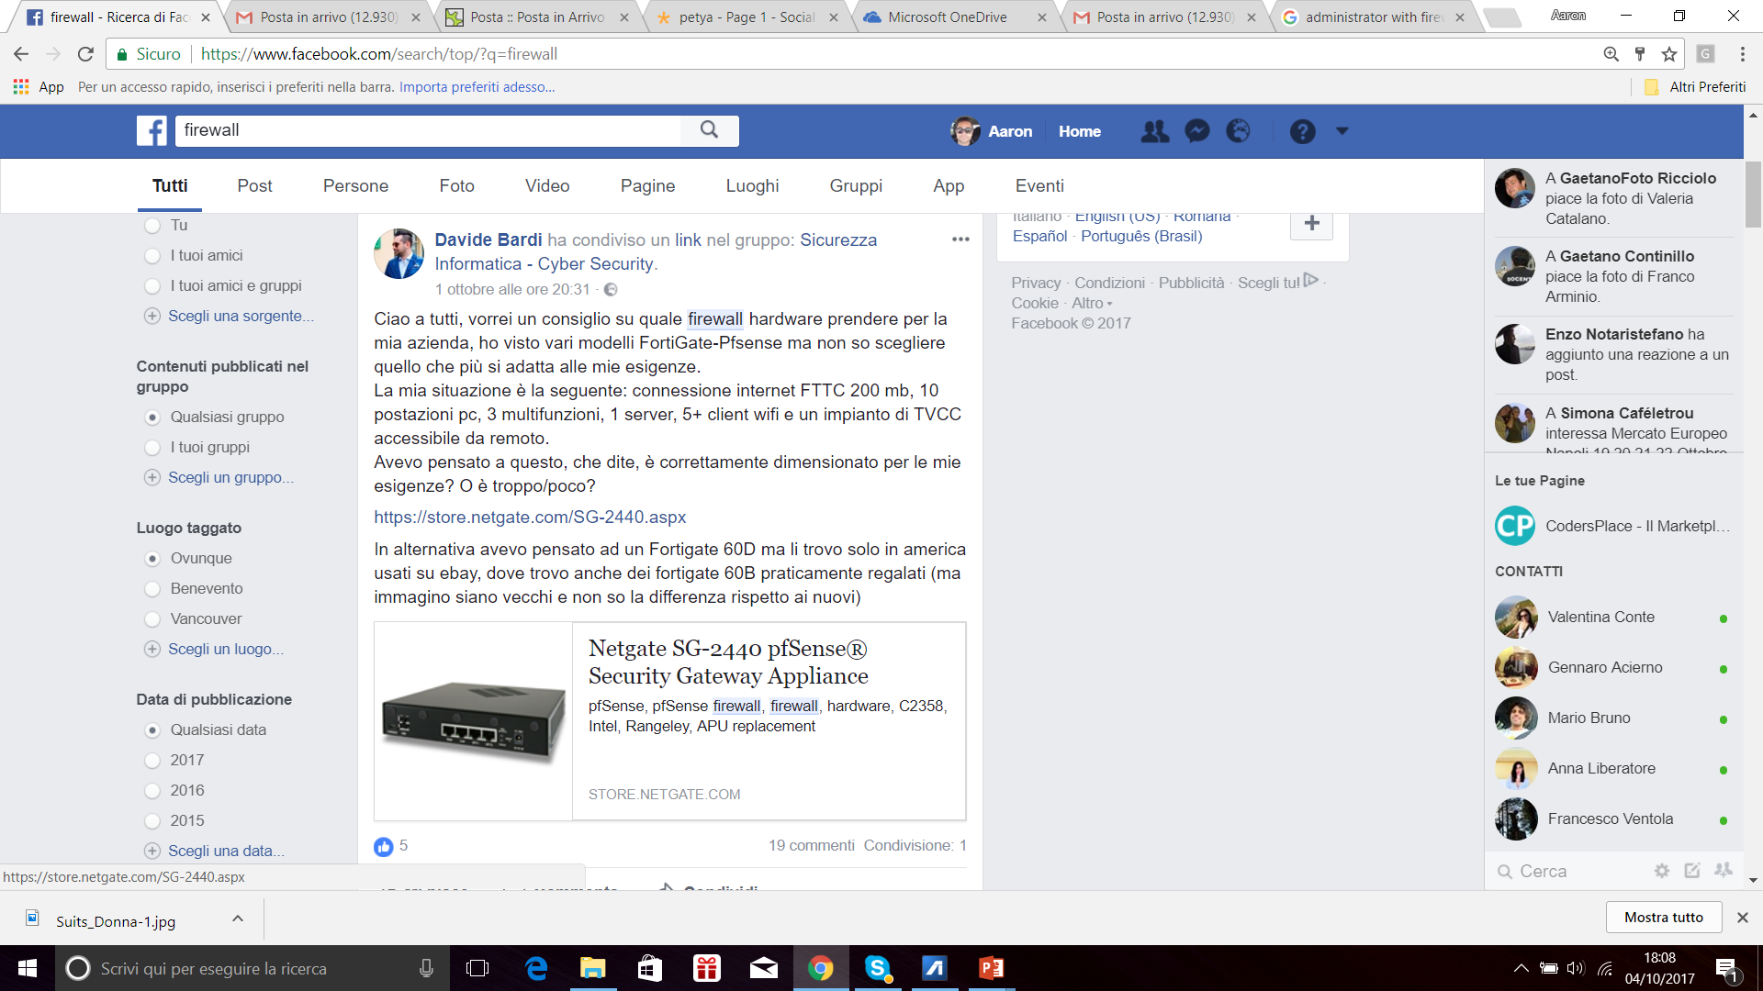

Slide 4
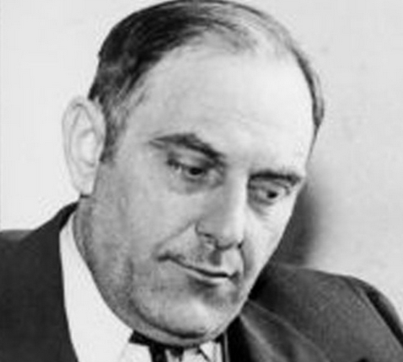
Victor Lustig: un classico della letteratura
Ha sfruttato la situazione economica
1925, la Francia si stava riprendendo dalla Prima guerra mondiale, e Parigi era in pieno fermento
I giornali diedero molto rilievo ai problemi per la manutenzione della Tour Eiffel l
a verniciatura era un onere non indifferente e la torre cominciava a mostrare segni di trascuratezza.
Ha personificato sempre qualcuno di estremamente autorevole
Un ottimo affare per gli acquirenti
Troppo bello per essere vero!
Ha venduto la Torre Eiffel a diverse persone
Le vittime erano troppo imbarazzate per andare alla polizia
Notes:
Si procurò documenti governativi falsi, che attestavano che egli fosse un funzionario statale incaricato della vendita della torre. Organizzò un incontro con sei dei più grandi commercianti di materiali ferrosi della Francia presso l'Hotel de Crillon, uno dei più prestigiosi alberghi della vecchia Parigi, presentandosi come l'assistente del direttore generale del ministero delle poste e telecomunicazioni.
Lustig affermò che il governo francese intendesse smantellare la torre, a causa del suo stato fatiscente. In effetti la torre fu progettata per essere il simbolo dell' Esposizione universale di Parigi del 1889 e nei piani originari doveva venire smontata vent'anni dopo, quindi il suo discorso venne reso da questo maggiormente credibile. Inoltre mise in rilievo il fatto che la torre stonasse con le cattedrali gotiche parigine.
Individuò in Andre Poisson la propria vittima. Chiese ai presenti di mantenere il segreto sull'incontro, spacciandolo per segreto di stato. Poisson, spinto dalla moglie insospettita dalla segretezza e dalla rapidità che Lustig usò, decise di chiedere spiegazioni. La risposta che ottenne fu che lo stato non gli aveva dato abbastanza soldi per finanziare una trattativa più lunga, e che aveva interesse a concludere in fretta la questione in quanto il proprio stipendio era relativamente basso rispetto allo stile di vita imposto dalla pomposità dell'evento.
Poisson, dedusse di trovarsi di fronte ad un funzionario corrotto che voleva una bustarella, di conseguenza cascò nella trappola e diede a Lustig i soldi per la torre più una "mancia" personale. Lustig scappò a Vienna insieme al suo complice Robert Arthur Tourbillon con una valigia piena di contanti. Poisson, scoperto l'inganno, si vergognò e decise di non denunciare l'accaduto.
Sei mesi dopo Lustig ritentò la truffa, ma uno dei possibili compratori si insospettì e denunciò il tutto. Lustig riuscì però a scappare insieme al suo complice.

Slide 5
La definizione
«la Social Engineering utilizza influenza e persuasione per ingannare la gente convincendo loro che l'ingegnere sociale è qualcuno che non è, è quindi un manipolatore. Come risultato, l’ ingegnere sociale è in grado di prendere vantaggio dalle persone per ottenere informazioni con o senza uso della tecnologia.»
Kevin Mitnick

Slide 6
Biosketch
Docente di Sicurezza Informatica presso
dip di Ing. Università del Sannio (laurea magistrale Ingegneria Informatica)
Università del Molise (laurea magistrale sicurezza informatica)
Membro European CyberSecurity Organization (EC)
Membro CINI Security Lab
Responsabile ISWATLAB (www.iswatlab.eu)
Fondatore di Ser&Practices
Interessi di ricerca
Malware Analysis
Software Security Engineering
Security Evangelist

Slide 7

Al bar qualcuno ha conosciuto qualcuna…
Hai un cane?
Noo! Io adoro gli animali. E come si chiama?
Mi dai la tua mail?
Sei un fan di Star Trek?
E qual è il personaggio che ti piace di più?

Slide 8
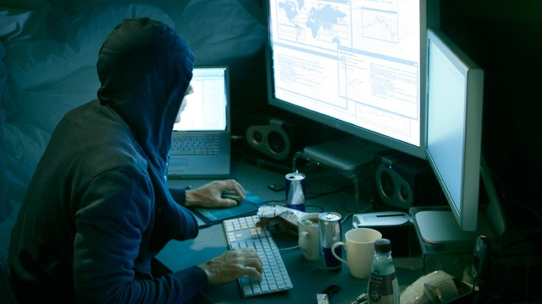
Nel frattempo, altrove…
Ci serve la sua mail
La domanda di sicurezza mi chiede come si chiama il cane
Mi porta su una mail secondaria. Dobbiamo trovare la password, prova a vedere con qualche telefilm

Slide 9
The problem
A survey (CheckPoint) of 850 IT and security professionals located in the US, Canada, UK, Germany, Australia and New Zeland found 48% had been victims of social engineering
Social engineering costs victims an average of $25,000-$100,000 per security incident
86% recognize social engineering as a growing concern, with the majority of respondents (51%) citing financial gain as the primary motivation of attacks, followed by competitive advantage and revenge.
Notes:
Socially-engineered attacks traditionally target people
with an implied knowledge or access to sensitive information,”
according to a statement from Check Point on the
survey. “Hackers today leverage a variety of techniques and
social networking applications to gather personal and professional
information about an individual in order to find
the weakest link in the organization.”

Slide 10
The problem
The most common attack vectors for social engineering attacks were phishing emails, which accounted for 47% of incidents, followed by social networking sites at 39%.
New employees are the most susceptible to social engineering, according to the report, followed by contractors (44%), executive assistants (38%), human resources (33%), business leaders (32%) and IT personnel (23%).
34% do not have any employee training or security policies in place to prevent social engineering techniques, although 19% have plans to implement one, according to Check Point.

Slide 11

Perché preoccuparci?
Gli esseri umani sono potenzialmente il link meno sicuro in un sistema sicuro
«Tu sei l’anello debole della catena»
«there is no patch for human stupidity»
H-Factor

Slide 12
A primer
The most powerful tool an attacker can use to access this knowledge is Social Engineering: manipulating a person into giving information to the social engineer.
It is consideedr the strongest form of attack
Infamous Compromissions through SE:
2009: Google's internal system was compromised in 2009 [2],
2011: The RSA security token system was broken in 2011 [1],
2013: Facebook was compromised in 2013 [4], as was the New York Times [40].

Slide 13
SE rulez
APTs often rely on a common initial attack vector: social engineering such as spear-phishing and water-holing.
Social engineering is the art of getting users to compromise information systems.
Technical protection measures are usually ineffective
people perform poorly on detecting lies and deception [42, 33].

Slide 14
Types of Attacks…
Physical attacks
the attacker performs some form of physical action in order to gather information on a future victim.
dumpster diving
theft or extortion
Social approaches
socio-psychological techniques such as Cialdini's principles of persuasion to manipulate their victims.
curiosity

Slide 15
… Types of Attacks…
Reverse social engineering
Instead of contacting a potential victim directly, an attacker can attempt to make them believe that he/she is a trustworthy entity.
sabotage, advertising, and assisting
Technical approaches
Technical attacks are mainly carried out over the Internet.
Web: Maltego, Social Engineering

Slide 16
… Types of Attacks
Socio-technical approaches
Combination of techiques
baiting attack
Phishing
Computer-supported collaboration
Office communication
Sophisticated technologies that protect the security of data transfer
face-to-face communication is often replaced by e-mails or instant messages -> new attack surface
External Communication
as the organizational border becomes increasingly blurred, it is difficult to decide which information may be published or passed on to an external communication partner.

Slide 17
Social engineering Taxonomy…
Channels
Email
Instant messaging
Telephone, VOIP
Social network
Cloud
Websites

Slide 18
… Types of Attacks
Operator
Human
Software
SET
Type
Physical
Technical
Social
Socio-technical

Slide 19
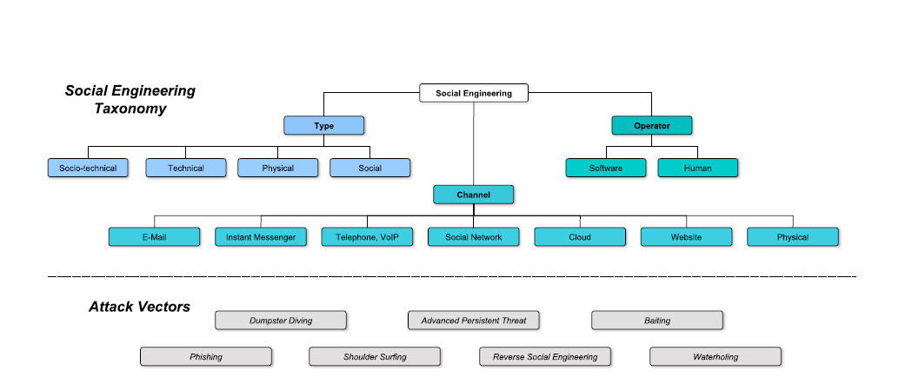

Slide 20
Real world examples…
RSA, 2011
A small number of employees received an e-mail with “2011 Recruitment Plan“
A number of employees thus directly opened the e-mail from the junk mail folder.
A spreadsheet attached with a zero-day exploit that installed a backdoor via an Adobe Flash vulnerability
compromised a number of strategic accounts and were able to steal sensitive information on RSA's SecurID system.
RSA had to replace millions of SecurID tokens

Slide 21
… Real world examples…
New York Times, 2013
Chinese hackers performed a 4-month targeted attack, infiltrating The New York Times computer systems and harvesting the employees' user credentials.
A spear-phishing attack which sent fake FedEx notifications.
the hackers stole the passwords of all employees at The New York Times and were thus able to access the personal devices of 53 people.

Slide 22
… Real world examples…
The Red October Cyber-espionage Network
Kaspersky Lab [3] recently released a new research report on spearphishing attacks against diplomatic, governmental and research organizations.
The attack was launched in 2007 and remained active until the beginning of 2013.
Sensitive data was stolen from research institutions, nuclear and energy groups, and aerospace organizations.
the attackers sent a spearphishing e-mail to a carefully selected group of people.
Stolen credentials were arranged in lists and then used to guess passwords of additional systems.
the attackers were located in a Russian-speaking country.

Slide 23
… Real world examples
Waterholing
Apple, Facebook, Twitter, 2013
The attackers rst compromised the development site "iPhoneDevSDK“
The website was modified to exploit the Java vulnerability on devices which visited the website.
the attackers exploited Twitter's network and were able to compromise about 250.000 user accounts, stealing user names, e-mail addresses, session tokens and encrypted passwords
malicious office documents are the most popular attack vectors, followed by malicious archives.

Slide 24
The case of the overconfident CEO
Lesson Learned 1: No information, regardless of its personal or emotional nature, is off limits for a social engineer seeking to do harm.
Lesson Learned 2: It is often the person who thinks he is most secure who poses the biggest vulnerability. Some experts believe executives are the easiest social engineering targets

Slide 25
The story
Hadnagy was hired as Se auditor to attempt to access the servers of a printing company.
The CEO told Hadnagy that hacking him would be next to impossible because he “guarded his secrets with his life.
Information gathering -> Hadnagy found
the locations of servers
Ip addresses
Phone number
Phisical addresses
Mail servers
Employee names and titles

Slide 26
The breach
Through Facebook he get personal details of CEO (favorite restaurant and sports team)
The prize: the CEO was involved in cancer fundraising
He called the CEO and posed as a fundraiser from a cancer charity the CEO had dealt with in the past
He informed him they were offering a prize (his favorite team match) drawing in exchange for donations
The CEO bit, and agreed to let Hadnagy send him a PDF with more information on the fund drive. He even managed to get the CEO to tell him which version of Adobe reader he was running. Soon after he sent the PDF, the CEO opened it, installing a shell that allowed Hadnagy to access his machine.

Slide 27
The theme park scandal
Lesson learned 3: Security policy is only as good as its enforcement.
Lesson learned 4: Criminals will often play to an employee’s desire to be helpful.
The target: the ticketing system of a theme park
Hadnagy started his test by calling the park, posing as a software salesperson. He was offering a new type of PDFreading software that he wanted the park to try through a trial offer. He asked what version they were currently using, obtained the information easily and was ready for step two.

Slide 28
The breach
Hadnagy asked one of the employees if they might use their computer to open a file from his email that contained a PDF attachment for a coupon that would give them discount admission.
The whole thing could have gone south if she said no,” explains Hadnagy. “But looking like a dad, with a kid anxious to get into the park, pulls at the heart strings.”
The employee agreed, and the park’s computer systemwas quickly compromised by Hadnagy’s bad PDF.

Slide 29
The hacker is hacked
Lesson learned 5: Social engineering can be part of an organization’s defense strategy.
Lesson learned 6: Criminals will often go for the lowhanging fruit. Anyone can be a target if security is low
Hadnagy profiles “John,” a penetration tester hired to conduct a standard network penetration test for a client. He ran a scan using Metasploit, which revealed an open VNC (virtual network computing) server, a server that allows control of other machines on the network.

Slide 30
The breach
He was documenting the find with the VNC session open when, suddenly in the background, a mouse began to move across the screen.
Taking a chance, John opened Notepad and began chatting with the intruder, posing as a new and unskilled hacker.
“He thought, ‘How can I get more information from this guy and be more valuable to my client?’”
“John played to the guy’s ego by trying to pretend he was a newbie who wanted to learn more from a master hacker.”
By the time the chat was over, he had the intruder’s email, contact information and even a picture of him. He reported the information back to his client, and the problem of easy access to the system was also fixed
Notes:
Hadnagy also points out that John learned through his
conversation with the hacker that the hacker had not really
been targeting the company; he had just been out looking
around for something easy to compromise and found the
open system quite easily.

Slide 31
On Social Networks
“I’m traveling in London and I’ve lost my wallet. Can you wire some money?”
“Someone has a secret crush on you! Download this application to find who!”
“Check out this link!”

Slide 32
In the Office
“This is Chris from tech services. I’ve been notified of an infection on your computer.”
“Can you hold the door for me? I don’t have my key/access card on me.”

Slide 33
Phishing lures
“You have not paid for the item you recently won on eBay. Please click here to pay.”
“You’ve been let go. Click here to register for severance pay.”

Slide 34
Targeted attacks
“This is Microsoft support —we want to help.”
“Donate to the hurricane recovery efforts!”
“About your job application...”
“@Twitterguy, what do you think about what Obama said on #cybersecurity? http://shar.es/HNGAt “
“Get more Twitter followers!”

Slide 35
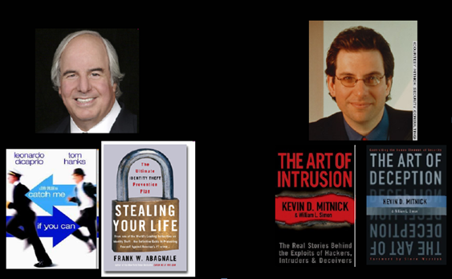
I più famosi…

Slide 36
Un problema aperto
«Le persone possono seguire ogni pratica di sicurezza raccomandata dagli esperti, installare pedissequamente ogni prodotto di sicurezza consigliato, ed essere ben vigili sulla corretta configurazione del sistema e applicando tutte le patch di sicurezza.
Questi individui sono ancora del tutto vulnerabili.»
Kevin Mitnick, The Art of Deception

Slide 37
Il problema siamo noi !
«L’ Ingegneria sociale sarà probabilmente sempre in auge, perché tante persone sono per natura disponibili e quindi molti dipendenti aziendali sono solitamente accomodanti. Gli attacchi sono rari, e le persone che chiedono informazioni o assistenza sono considerate legittime. Ricoprendosi dello stato di vittima, l'attaccante è di solito in grado di ottenere facilmente ciò che vuole.»
Bruce Schneier, “Beyond Fear”

Slide 38
SE: perché?
È più facile ingannare qualcuno e farsi dare la sua password di un sistema piuttosto che perdere del tempo nell’ hackerarla.
Il white hat hacker Archangel (soprannominato "The Greatest Social Engineer of All Time") ha dimostrato che le tecniche di SE permettono di ottenere qualsiasi cosa come:
Password
Pizza
Automobili
Biglietti aerei

Slide 39
SE: I metodi
Offrire aiuto per risolvere un problema
Invio di software libero o patch da installare
Usare (false) finestre di pop-up che richiedono l’autenticazione
Loggare tutto ciò che è digitato sulla tastiera della vittima
Lasciare in giro un CD/SD/USB stick con del codice malevolo
Utilizzo dell’ ars oratoria per ottenere fiducia
Offrire una ricompensa in cambio della registrazione ad un sito web

Slide 40
SE: I metodi
Chiedere un trasferimento file in una macchina apparentemente interna alla rete aziendale
Recuperare gli avvisi di richiamata delle caselle vocali, facendo sembrare l’attacco proveniente dall’ interno
Fingere di essere:
collega
fornitore
figura autoritaria della compagnia da attaccare
nuovo dipendente in cerca di aiuto
Software vendor che offre patch, etc.

Slide 41
Segni premonitori di un attacco
Il rifiuto a dare il numero per la richiamata
Richieste fuori dall’ordinario
Rivendicazione di autorità
Insistenza sull’ urgenza
Minacce sulle conseguenze negative a causa dell’ inadempienza
Segni di disagio se interrogato
Omissione del nome
Complimenti o adulazione
Flirtare

Slide 42
Obiettivi comuni di attacchi
Receptionist: ignaro di poter rivelare informazioni importanti
Help desk tecnico: in quanto hanno accessi privilegiati ai software per i quali offrono supporto
Vendors: produttori di software
Accounting, risorse umane (HR): specifici dipartimenti ad alto contenuto sensibile

Slide 43
Possible contributing factors
Organizational factors: data flow, work setting, work planning and control, and employee readiness
Human factors: lack of situation awareness, issues relating to risk tolerance and risk perception, inadequate knowledge, flawed reasoning and decision making, and illness, injury, and other health-related factors that diminish decision making, judgment, or other cognitive capabilities
Demographic factors: age, gender, and cultural factors

Slide 44
UIT Threat Vectors
DISC, or accidental disclosure (e.g., via the internet)—sensitive information posted publicly on a website, mishandled, or sent to the wrong party via email, fax, or mail
UIT-HACK, or malicious code (UIT-HACKing, malware/spyware)—an outsider’s electronic entry acquired through social engineering (e.g., phishing email attack, planted or unauthorized USB drive) and carried out via software, such as malware and spyware
PHYS, or improper/accidental disposal of physical records—lost, discarded, or stolen nonelectronic records, such as paper documents
PORT, or portable equipment no longer in possession—lost, discarded, or stolen data storage device, such as a laptop, personal digital assistant (PDA), smartphone, portable memory device, CD, hard drive, or data tape
49% of the UIT cases were associated with the DISC threat vector, 6% with PHYS, 28% with PORT, and 17% with UIT-HACK

Slide 45
Unintentional Insider Threat
An unintentional insider threat is
a current or former employee, contractor, or business partner
who has or had authorized access to an organization’s network, system, or data and
who, through action or inaction without malicious intent, unwittingly
causes
harm or
increases the probability of future serious harm to the confidentiality, integrity, or availability of the organization’s resources or assets, including information, information systems, or financial systems.

Slide 46
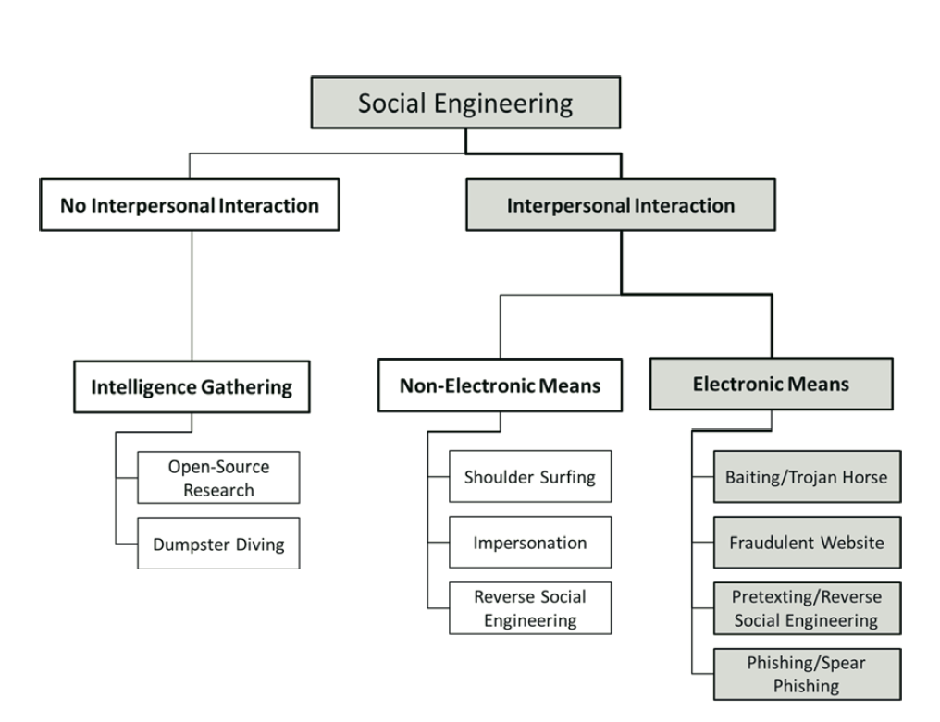

Slide 47
Social Engineering Characteristics

Slide 48

Heuristics and Biases
Heuristic thinking
Proceeding by trial and error, rather than by systematic analysis
Basing decisions solely on previous outcomes
Relying on “gut instinct”
Cognitive Biases
Bandwagon effect
“Just following orders”
Foot-in-the-door effect

Slide 49
Heuristic thinking
In social situations, people tend to think less systematically, more heuristically
Heuristic thinking serves a purpose
Organizations desire efficiency
Elimination of all shortcuts, rules of thumb, and biases would seriously impact productivity
Problem
Outcomes of heuristic thinking are predictable
Easily manipulated by social engineer

Slide 50
Social Engineering Attack Cycle

Slide 51
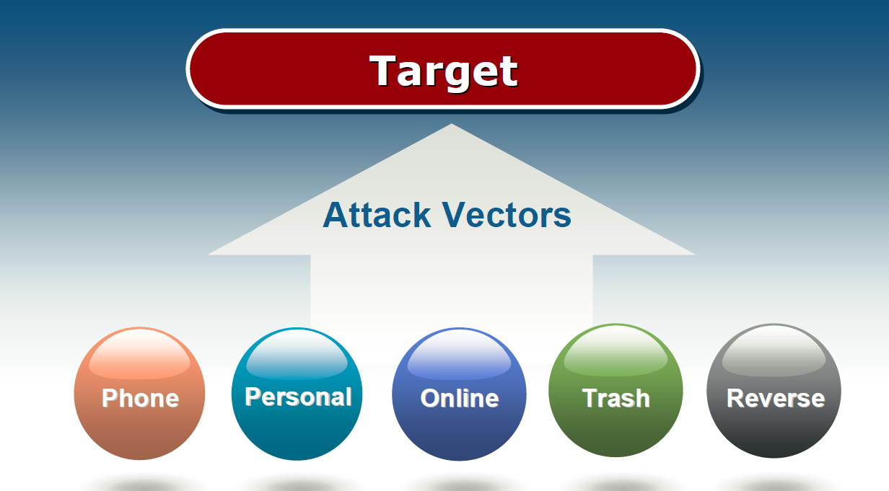
Social Engineering Attack Vectors

Slide 52
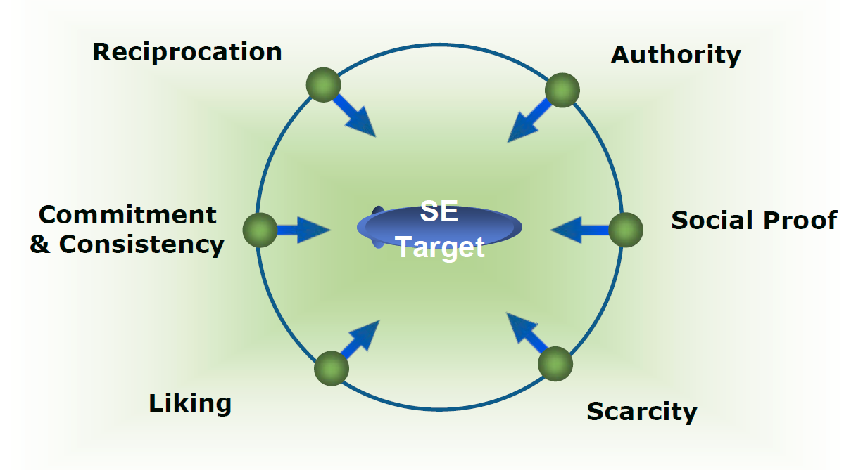
Psychological Triggers

Slide 53
Reciprocation
Reciprocation
Taking advantage of human desire to respond in kind to perceived favors
Cup of coffee for your password?
Methods of Attack
Offer false information to “help”user which forms an underlying obligation(reverse social engineering)
Yield points in an argument

Slide 54
Authority
Authority
People generally tend to conform to the dictates of authority figures
Milgram psychology experiments
Fast food strip-search case
Methods of Attack
Telephone
Call to obtain a forgotten password or other information
In Person
Clothing, falsified badges

Slide 55
Commitment & Consistency
Commitment and Consistency
Once we take a stand or commit, we need to be (and appear) consistent with what we have already said and done
Race track experiment
The gym membership
Methods of Attack
Give a new employee a false security policy,then request their password to verify against policy
Information by attrition

Slide 56
Social Proof
Social Proof
Pressure to follow the crowd
Celebrity endorsements
Canned laughter
Methods of Attack
Name dropping to influence actions
“Linda and Bob in accounting gave me their passwords. Now I need yours.”

Slide 57
Liking and Similarity
Liking and Similarity
Humans naturally tend to associate with those who like the same things, or are similar to them in some way
Method of Attack
Through conversation, attacker probes for apersonal connection to establish rapport
“You like football? So do I! How about those Redskins!”

Slide 58
Scarcity
Scarcity
People tend to comply when they believe that an object is in short supply, highly sought after, or is available only in scarce quantities
Methods of Attack
Phishing emails
Pop-ups
“Click here to download software to prevent further pop-ups!”

Slide 59
Fattori che rendono le aziende vulnerabili
Grande numero di dipendenti
Diverse strutture
Informazioni sulle dislocazioni fisiche dei dipendenti recuperabili dai messaggi lasciati sulle segreterie telefoniche
Recapito privato o altre informazioni recuperabili dalla segreteria telefonica
assenza di formazione sulla sicurezza
assenza di un sistema di classificazione dei dati sulla base della loro sensibilità

Slide 60
Espedienti per applicare tecniche di SE
Il pretexting (ovvero il pretesto) può anche essere usato per personificare colleghi, poliziotti, bancari, autorità fiscali o investigatori assicurativi
in generale qualsiasi altro individuo o autorità che nella mente del target possa essere percepito come un individuo che abbia il diritto di chiedere tali informazioni.
Il pretexter deve semplicemente preparare le risposte alle domande che potrebbero essere poste dal bersaglio.
In alcuni casi, tutto quello che serve è una voce del giusto genere, un tono serio e la capacità di «restare nel ruolo».

Slide 61
Espedienti per applicare tecniche di SE
Phishing: invio di e-mail che sembrano provenire da un mittente legittimo (es. una banca, o un ente di riscossione), con la richiesta di «verifica» di informazioni personali con conseguenze catastrofiche sul proprio saldo in caso di mancata esecuzione.
La lettera di solito contiene un link ad una pagina web fraudolenta che sembra legittimo
con loghi e contenuti del mittente legittimo
con un modulo di richiesta nel quale inserire i dati richiesti

Slide 62
Tecniche di social engineering IVR / phishing telefonico
Questa tecnica utilizza un Interactive Voice Response (IVR) per ricreare una copia di un suono legittimo di una banca o di una istituzione.
un sistema IVR, di solito, consente di impostare un insieme di messaggi preregistrati, prevede menu a scelta multipla, memorizza dati introdotti da tastiera, invia fax, interroga sia database aziendali che sistemi informatici.
solitamente utilizzato per alleggerire il lavoro nei call center

Slide 63
Tecniche di social engineering IVR / phishing telefonico
La vittima viene invitata (in genere tramite una phishing e-mail) a chiamare la «banca» (attraverso un numero verde) e verificare le informazioni.
La presenza di un numero verde aumenta il grado di fiducia della vittima
In sistemi avanzati la vittima dell’attacco sarà messa in contatto telefonico con l’attacker, il quale fingendosi un impiegato dell’istituto contattato sarà ben lieto di offrire delucidazioni sulla questione…

Slide 64
Social Engineering Techniques: Trojan Horses
Utilizzati per distribuire malware su larga scala, facendo leva sulla curiosità dell’utente medio.
I cavalli di Troia possono essere distribuiti come allegati alle e-mail promettendo di tutto, da uno screen saver «cool» , a un importante aggiornamento dell’ anti-virus o un aggiornamento del sistema operativo.
Solitamente l’utente medio cede alla curiosità di aprire l'allegato.
Inoltre, molti utenti ciecamente aprono qualsiasi allegato ricevuto
anche se il mittente non è conosciuto

Slide 65
Social Engineering Techniques: Road Apple
Una road apple è una variante del mondo reale di un cavallo di Troia che utilizza supporti fisici
fa sempre leva sulla curiosità della vittima.
L'attacker lascia un CD-ROM, una scheda di memoria o una chiave USB infetta in una posizione nella quale sarà sicuramente trovata (bagno, ascensore, marciapiede) e semplicemente aspetta...
La cosa può essere resa più accattivante aggiungendo il logo aziendale, o una etichetta con la dicitura «Riassunto Stipendi Q1 2006» in bella vista.

Slide 66
Social Engineering Techniques: quid pro quo
Un utente malintenzionato chiama numeri casuali presso una società spacciandosi per il supporto tecnico, affermando di essere stato chiamato da un dipendente.
Alla fine si colpirà qualcuno effettivamente alle prese con un problema, grato che qualcuno stia chiamando per aiutarlo.
L'attaccante sarà lieto di «aiutare» a risolvere il problema, magari con una patch software
ovviamente lanciando la patch si avvia il processo del malware.
In un sondaggio sulla sicurezza informatica del 2003, il 90% dei impiegati ha affermato di aver comunicato la password a tecnici al di fuori della propria azienda.

Slide 67
Social Engineering Techniques
Usano le varie forme di comunicazione, come ad esempio e-mail, internet, telefono, ma anche interazioni «face2face» per perpetrare il loro schema per frodare ed infiltrarsi nella rete aziendale.
Secondo Check Point Software Technologies, quasi la metà delle imprese intervistate nel 2011 ha dichiarato di essere stata vittima di uno o più attacchi di ingegneria sociale che hanno determinato perdite che vanno da $ 25.000 a $ 100.000 per attacco.

Slide 68
SE: strategie antifrode
è essenziale che i dipendenti dell'intera organizzazione siano educati e addestrati su come individuare e prevenire questo tipo di frode.
Necessità da parte delle aziende di sviluppare e attuare politiche specifiche (ad esempio, la formazione dei dipendenti sul pericolo che costituisce la diffusione di informazioni riservate e sensibili e su come mantenerle al sicuro) per prevenire e rispondere a un attacco.

Slide 69
SE: strategie antifrode
Un piano per mitigare gli effetti degli attacchi di ingegneria sociale dovrebbe essere una parte di una qualsiasi politica di sicurezza aziendale.
Dovrebbe includere una componente per rendere consapevoli i dipendenti e educare coloro che sono più vulnerabili:
i nuovi assunti, il personale di help desk, imprenditori, assistenti esecutivi, personale delle risorse umane, senior manager e dirigenti, così come le risorse IT, ovvero i dipendenti che gestiscono la sicurezza tecnica e fisica dell’infrastruttura telematica.

Slide 70
SE: strategie antifrode
Condurre una valutazione sui dati per classificare il livello di sensibilità delle informazioni in essi contenuti, identificando quali dipendenti devono averne accesso.
Identificando anche i tipi di accesso di cui necessitano
In quali momenti della giornata
E da quali postazioni
Tutti dipendenti sono a rischio.

Slide 71
SE: strategie antifrode
Non rilasciare mai informazioni riservate o sensibili a qualcuno che non ha un motivo valido per averle, anche se la persona si identifica come un collega di lavoro, un superiore o un rappresentante dell’ IT.
Se la password deve essere condivisa, non dovrebbe mai essere rivelata al di fuori dell’ azienda
o per telefono, via e-mail o sul web.

Slide 72
SE: strategie antifrode
Stabilire le procedure da mettere in atto prima di effettuare una transazione finanziaria telematica.
Ridurre la dipendenza da e-mail per tutte le transazioni finanziarie. Se l’e-mail deve essere utilizzata, stabilire procedure di call-back con clienti e fornitori per tutti trasferimenti di fondi in uscita a un numero telefonico precedentemente stabilito, o implementare un sistema di verifica del cliente basato su doppia verifica.

Slide 73
SE: strategie antifrode
Stabilire procedure per verificare eventuali modifiche al cliente o semplicemente per fornirgli dettagli, indipendentemente dal richiedente della modifica.
Evitare di utilizzare «dispositivi non autorizzati» come penne USB/CD-ROM personali contenenti software o contenuti multimediali su un computer aziendale.

Slide 74
SE: strategie antifrode
Porre cautela nelle situazioni in cui una parte
rifiuta di fornire informazioni di contatto di base (come ad esempio l’ufficio dal quale sta telefonando),
usa un linguaggio intimidatorio,
mostra di aver fretta senza dare il tempo all’ interlocutore di pensare o richiede informazioni riservate.
I documenti fisici e altro materiale tangibile, come i file generati, o gli stessi calcolatori, hardware e software, devono sempre essere triturati e/o distrutti prima dello smaltimento negli appositi recipienti.

Slide 75
SE: strategie antifrode
Combattere lo scambio immotivato di informazioni riservate nei luoghi di lavoro mediante l'attuazione di programmi di sensibilizzazione e di formazione interna.
Questo include lo sviluppo di una segnalazione degli incidenti e un programma di monitoraggio per catalogare gli attacchi di ingegneria sociale e l'attuazione di una strategia di risposta all’ incidente.

Slide 76
SE: strategie antifrode
Personale di guardia contro accessi fisici non autorizzati, mantenendo strette politiche sulla visualizzazione dei badge di sicurezza e altre eventuali credenziali
Tutti gli ospiti devono essere scortati
Mantenere le aree sensibili, come le sale server, gli armadi dei telefono e in generale tutte le aree strategiche in piena sicurezza dal personale di sorveglianza in ogni momento.

Slide 77
SE: strategie antifrode
Monitorare l'utilizzo dei mezzi di comunicazione sociale, delle fonti on-line e delle informazioni commerciali per evitare che informazioni sensibili vengano pubblicate su Internet.
Incluse le reti sociali

Slide 78
Esempi di attacchi: Phishing
Account Activity locked!
Dear Valued Customer,
Our security department notice several access into your account from a foreign IP address and automatically your account activity was locked for security reason.
However, kindly click here to update and re-activate your account online banking
profile.
Your security is important to us. For further inquiries, please contact us immediately
at 1.800.432.1000
This alert relates to your Online Banking profile, rather than a particular account. This
alert is for verification purposes only.
For security reasons, open this link on internet explorer browser and disable pop-up blocker.
Want to get more alerts? Sign in to your online banking account at Bank of America and within the Accounts Overview page select the "Alerts" tab.

Slide 79
Chat Attack
<Cthon98> hey, if you type in your pw, it will show as stars
<Cthon98> ********* see!
<AzureDiamond> hunter2
<AzureDiamond> doesnt look like stars to me
<Cthon98> <AzureDiamond> *******
<Cthon98> thats what I see
<AzureDiamond> oh, really?
<Cthon98> Absolutely
<AzureDiamond> you can go hunter2 my hunter2-ing hunter2
<AzureDiamond> haha, does that look funny to you?
<Cthon98> lol, yes. See, when YOU type hunter2, it shows to us as *******
<AzureDiamond> thats neat, I didnt know IRC did that
<Cthon98> yep, no matter how many times you type hunter2, it will show to us as *******
<AzureDiamond> awesome!
<AzureDiamond> wait, how do you know my pw?
<Cthon98> I just copy pasted YOUR ******'s and it appears to YOU as hunter2 cause its your pw
.

Slide 80
Voice Mail
“You’ve reached Bob, Director of R&D. I’ll be out of the office until April 1st. If you need immediate assistance please call Tom, Assistant Director, at x123.”
“You’ve reach Susan, I will be on client site today and tomorrow but checking voicemail and email. You can reach me on my cell at 555-1234.”

Slide 81
Email Response
I am out of the office and will return on 01/20/2010.
If urgent, please call: Paula, Acting Chief at 202-555-5555.

Slide 82
Dumpster Diving
Tutto ciò che è lasciato per il ritiro non rientra più nella proprietà privata
Può essere ancora definito come proprietà privata solo se non deve oltrepassare la proprietà privata dell’azienda per arrivare al punto di ritiro
non lasciare quindi niente sul marciapiede durante la notte
Triturare in ogni caso i documenti cartacei
“Set it and forget it”

Slide 83
divulgazione al pubblico
interviste
conferenze
intercettazione da «Starbucks»
confessioni al «Blackberry»
chiacchierate apparentemente informali
La sigaretta è un alleata dell’ ingegnere sociale…

Slide 84
Pretexting
La pratica di ottenere informazioni personali sotto falsi pretesti.
Ad esempio indagini, per conto dell’azienda stessa o anche da parte di organi statali
2006: lo scandalo della HP

Slide 85
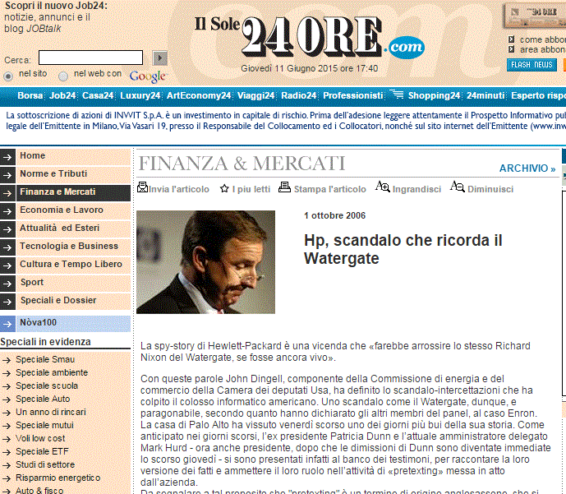

Slide 86
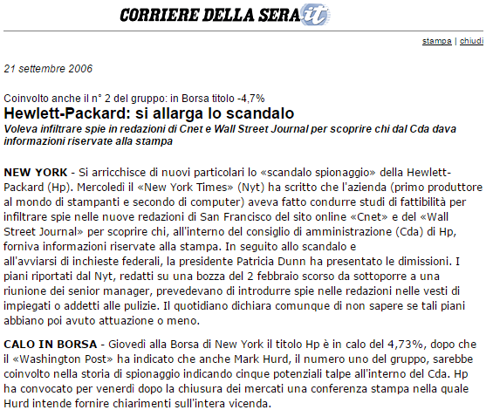

Slide 87

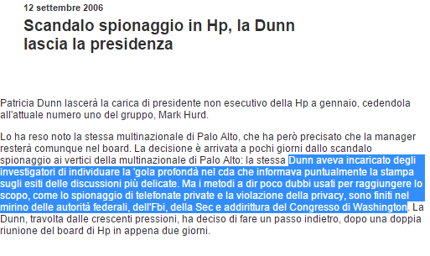

Slide 88
Utilizzo delle reti sociali
Nessuna autenticazione reale
Facile impersonare chiunque attraverso un profilo falso
Principio dell’influenza di Cialdini
la gente fa cose che gli altri stanno facendo
Le persone sono influenzate dalle persone che seguono

Slide 89
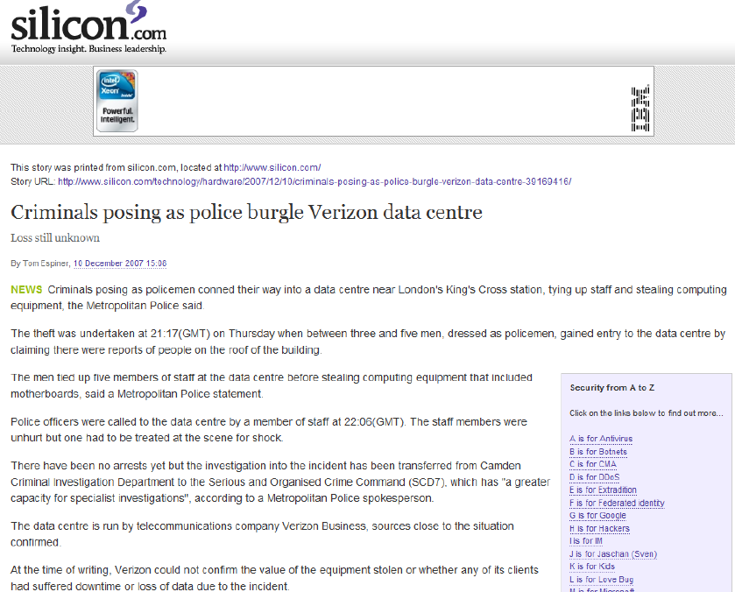
Personificazione nel mondo reale

Slide 90
Personificazione nel mondo reale
Richiede un forte investimento iniziale
comprare, ad esempio, divise delle forze dell’ordine
Si commettono altri crimini
fingersi un pubblico ufficiale, danneggiare le vittime fisicamente
Richiede molta pianificazione
Solitamente coinvolge più persone
Molto più facile essere scoperti

Slide 91
Gli strumenti utili per la SE
Recupero di informazioni attraverso tools come Maltego, Creepy
Social Engineers Toolkit (SET)
Programmi di grafica (Photoshop/GIMP) per falsificare carte di identità e documenti
SpoofCard/ SpoofApp per recuperare numeri telefonici

Slide 92
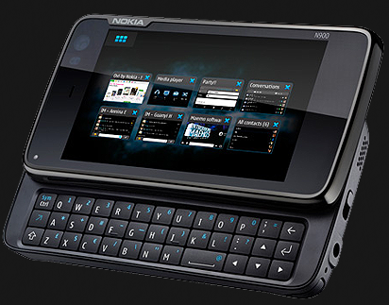
Hardware per il SE
Pwnphone
$960 da pwnieexpress.com
O scaricare l’app sul proprio device
Permette di eseguire pentesting
incredibilmente facile valutare reti cablate, wireless e Bluetooth.

Slide 93
SE as a Service
L’ultima frontiera della SE
Diversi servizi utili per l’Ingegneria Sociale
Chiamate telefoniche professionali (sia maschili che femminili) in numerosi linguaggi
Mascheramento ID di chiamata
Possibilità di programmare le telefonate a seconda degli orari di lavoro della vittima designata
Costo: 7/15$ per chiamata

Slide 94
Possibili punti di vulnerabilità da esplorare
Attacchi di forza bruta sulle password
Firewall
Router
PBX
è una centrale telefonica per uso privato usata per fornire una rete telefonica interna, tipicamente allacciandola alla rete telefonica generale esterna
Autoplay abilitato

Slide 95
The Social-Engineer Toolkit (SET)
Open-Source sviluppato in Python.
SET utilizza Metasploit sia per il repository degli exploit che per gli attacchi lato client.
vettori di attacco multipli progettati specificatamente per l’ Ingegneria Sociale.
è diventato lo standard nella Social Engineering per numero di test di penetrazione.
un «must-have» per ogni pentester
https://www.trustedsec.com/social-engineer-toolkit/

Slide 96
The Social-Engineer Toolkit (SET)
Il framework contiene una serie di attacchi mirati a compromettere la sicurezza di un’organizzazione
ma anche di un singolo individuo
utilizza tecniche di social engineering che sfruttano le “human vulnerabilities”.
SET, giunto alla release 4, è presente in Backtrack
distribuzione Linux Open Source distribuita come Live DVD, basata su Debian/Ubuntu

Slide 97
SET: vettori di attacco
Attacchi di phishing
Attacchi Web: vettori di attacco multipli compresi exploit client-side, man in the middle, e attacco brute-force alle credenziali.
creazione Autorun: permette di distribuire payload MSF (metaesploit) in un semplice autorun.
attacco su Arduino / Teensy USB HID con selezione payload per attacchi su tastiere con hub USB.

Slide 98
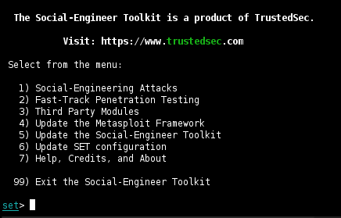
Menù A la Carte

Slide 99
SET in action: creiamo un sito civetta
Scegliamo dal menu l’opzione 1) “Social-Engineering Attacks”.
Nel menu successivo selezioniamo l’opzione 2) “Website Attack Vectors” e poi l’opzione 3) “Credential Harvester Attack Method”.
A questo punto abbiamo 3 possibilità: utilizzare un template già pronto del nostro sito civetta oppure effettuare un cloning “al volo”. La terza opzione invece ci consente di importare in SET un sito costruito da noi per l’occasione (“Custom Import”). Scegliamo quindi l’opzione 1) “Web Templates”.
In questo modo stiamo importando in SET un template già pronto, che però potrebbe non essere aggiornato rispetto a quello pubblicato online.

Slide 100
SET in action: creiamo un sito civetta
Ma allora: “perché non utilizzare direttamente l’opzione 2 e clonare il sito on-the-fly?”.
il sito clonato solitamente non corrisponde esattamente a quello originale perché probabilmente viene effettuata la copia della sola parte deputata al login.
Però possiamo sempre salvare una copia della pagina iniziale di Facebook ☺

Slide 101
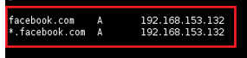
SET in action: creiamo un sito civetta
È necessario ora ridirezionare tutto il traffico destinato a Facebook
ma anche ad ogni altro sottodominio o server (come ad es. www) di facebook.com, verso la macchina attacker che nel caso in esempio ha indirizzo IP 192.168.153.132.
A questo punto SET, carica il template del sito e avvia il web server sulla macchina attacker, che si pone in ascolto sulla porta 80 (TCP)

Slide 102
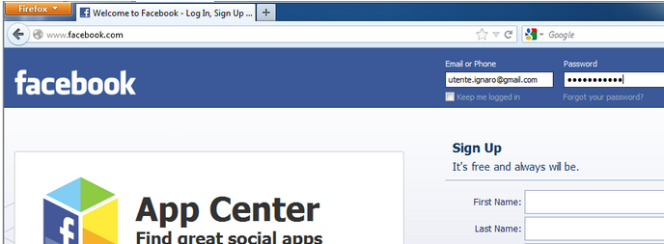
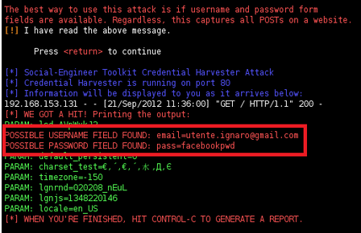
SET in action

Slide 103
My two cents
La buona riuscita dell’attacco prevede come unico prerequisito quello di trovarsi sullo stesso segmento di sottorete della/e vittima/e
sia in caso di LAN cablata, sia Wireless.
la tecnica utilizzata consiste nel presentare alla vittima, al posto del sito web originale, un clone identico a quest’ultimo, in cui il malcapitato utente andrà ad immettere le proprie credenziali di accesso
Sostituzione entry del DNS che punta ad un web server alternativo (quello integrato in SET)

Slide 104
Scenario 1 - USB HID Attack Vector
Inviare ad un dipendente una tastiera nuova magari con il logo aziendale in bella mostra, accompagnata da una lettera informativa sugli aggiornamenti delle tastiere.
Collegato il dispositivo, i sensori di movimento rilevano se l'utente si trova sul sistema o meno.
Anche il mouse viene spostato di 1 pixel ogni 3 minuti per garantire che lo schermo non si blocchi.

Slide 105
Keyboard attack
Aggira tutte le funzionalità di esecuzione automatica per eseguire codice arbitrario nel sistema.
può rilasciare file binari maligni, sfruttare l’overflow, utilizzare downloader, keystroke logger o backdoor.
Nascosto facilmente nei dispositivi periferici come mouse, tastiera, computer, chiavette USB, e molto altro...

Slide 106
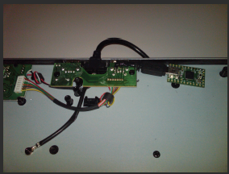

Integrabile nel proprio hardware
La maggior parte delle nuove tastiere integrano hub USB…

Slide 107
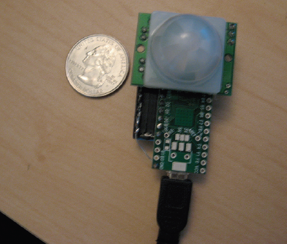
Sensore di Movimento

Slide 108
Scenario 2 - Java Applet Attack
Si esegue la fase di ricognizione per scoprire il maggior numero di informazioni sulla società target. Si acquisisce il loro gergo, la struttura interna, gli indirizzi e-mail
Si trova il pretesto!
Si registra un nome di dominio simile a quello delle vittime designate.
Si contatta il reparto vendite e si dichiara di essere un cliente che ha problemi di connessione al «nuovo» sito aziendale.

Slide 109
Thomas Werth Attack Vector
Rilasciato a ShmooCon, questo vettore di attacco consente di creare ad un malintenzionato delle applet Java con fine malevoli.
ShmooCon è un convegno annuale di hacker
La vittima visita il sito ed il payload viene eseguito sulla macchina target
Reindirizza l’utente sul sito originale per rendere l'attacco meno visibile.

Slide 110
Multi Attack
Si vuole garantire che se un'opzione fallisce, ci siano molteplici ridondanze al fine di garantire alti tassi di successo dell’ attacco.
Si contatta l’IT Help Desk sostenendo di essere un alto dipendente che sta avendo problemi nel raggiungere un sito web critico.
la vittima riceverà una chiamata che sembrerà provenire da un numero dirigenziale
Esistono app e servizi web per cambiare l’id del chiamante
Senza necessità di acquisire i privilegi di root sul device

Slide 111
Perché tutto ciò è efficace?
Siamo esseri umani, siamo programmati dalla nascita attraverso le nostre vite ad agire e comportarsi in un certo modo.
I nostri cervelli lavorano tutti allo stesso modo, siamo tutti vulnerabili quindi
…e non c'è davvero nessuna patch.

Slide 112
Perché usare SET?
Implementa realmente gli attacchi.
Strumenti del genere dovrebbero essere incorporati nelle normali metodologie di pentesting.
Solo personale adeguatamente addestrato può evitare di essere adescato da queste trappole

Slide 113
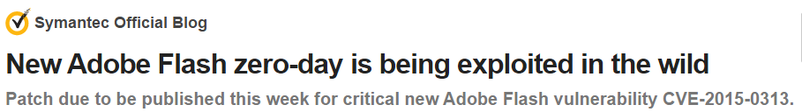
Zero-day attacks
Gli zero-day sono definiti come vettori di attacco per i quali non è stata trovata nessuna patch
Sono là fuori, non sono pubblici e essi possono mietere vittime per anni senza contromisure.
Adobe è stata recentemente colpita quasi ogni settimana con un nuovo zero-day.
L’ultimo è del 2 Febbraio 2015

Slide 114
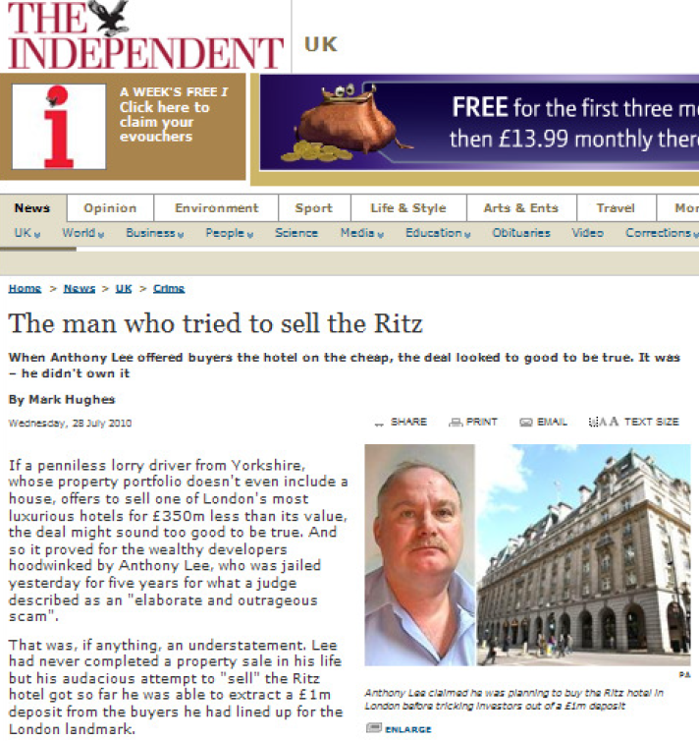

Slide 115
Social Engineering 10-20 anni fa
Love Bug Virus: primo tipo di attacco in cui vengono ricevute e-email da mittenti conosciuti
Script semplice con il codice in chiaro (non offuscato)
Primo attacco di phishing
Metà anni 90 quando AOL ha iniziato ad effettuare controlli per evitare frodi di credito
I phishers si fingevano dipendenti di AOL ed inviavano messaggi alle vittime nelle quali chiedevano le loro credenziali
Notes:
ILOVEYOU, sometimes referred to as Love Letter, was a computer worm that attacked tens of millions of Windows personal computers on and after 5 May 2000^{[1]} local time in the Philippines when it started spreading as an email message with the subject line "ILOVEYOU" and the attachment "LOVE-LETTER-FOR-YOU.txt.vbs". The latter file extension (in this case, 'VBS' - a type of interpreted file) was most often hidden by default on Windows computers of the time, leading unwitting users to think it was a normal text file. Opening the attachment activated the Visual Basic script. The worm did damage on the local machine, overwriting image files, and sent a copy of itself to all addresses^{[2]} in the Windows Address Book used by Microsoft Outlook. In contrast, the Melissa virus only sent copies to the first 50 contacts.

Slide 116
Il futuro della SE
Stessi trucchi, nuove tecnologie
Attacchi più sofisticati
Più informazioni, profilazione più facile
Tecnologia per migliorare/ automatizzare gli attacchi
Social engineering as a service

Slide 117

Il prigioniero spagnolo
risale al 16 ° secolo nell'era della Armata Spagnola.
Il truffatore, scortato da una bella signora, avvicina nobili britannici con la storia che il padre della signora, un vero gentiluomo, era stato imprigionato in Spagna.
Una lettera scritta dal prigioniero è mostrata come prova.
Se il nobile britannico avesse pagato il riscatto per padre incarcerato, quest’ultimo come ricompensa per la sua liberazione avrebbe concesso la mano di sua figlia al nobile britannico.

Slide 118
La lettera da Gerusalemme
Una variante del prigioniero spagnolo risalente ai secoli 18° e 19 °, con una lettera molto simile, dal titolo “La Lettera da Gerusalemme”.
L’autore è Eugène François Vidocq, un investigatore criminale e privato francese.
appare molto simile ad alcune e-mail che arrivano ancora oggi: "Signore, sarete senza dubbio stupiti di avere ricevuto una lettera da una persona sconosciuta a voi, che sta per chiedere un favore... ", e continua a parlare di un cofanetto contenente 16.000 franchi in oro e diamanti ed una richiesta di anticipo per poterli ritirare.

Slide 119
Frodi Nigeriane degli anni ‘80
nei primi anni '80, la Nigeria ha vissuto una profonda crisi nel settore petrolifero.
Alcuni studenti universitari disoccupati idearono una truffa per manipolare i visitatori interessati a stipulare accordi petroliferi loschi.
Hanno continuato a colpire gli uomini d'affari in Occidente, attraverso messaggi postali, fax, telex
e, ovviamente, e-mail

Slide 120
Frode 419 – Dicembre 2009
Salve,
questo messaggio potrebbe sorprenderla, tuttavia ho un bisogno urgente di un partner straniero per effettuare una transazione. Sono un banchiere di professione e sono del Burkina Faso in Africa occidentale e attualmente occupo la carica di direttore della contabilità della mia banca. Ho l’opportunità di trasferire dei fondi (12,5 milioni di dollari) di uno dei miei clienti morto insieme a tutta la sua famiglia il 31 luglio 2000 in un incidente aereo. È possibile confermare il decesso del mio cliente cliccando su questo sito: http://news.bbc.co.uk/1/hi/world/europe/859479.stm
Detto ciò; le scrivo per proporle il seguente affare: dividere questo denaro fra di noi nel rapporto di 60/38 mentre il 2% sarà trattenuto per le spese.
Ulteriori dettagli del trasferimento le saranno inoltrati non appena ricevo la sua conferma.
Saluti, Mr. Salam Ahmed

Slide 121
Truffa “amichevole”
Ciao, come stai?
Mi dispiace di non averti informato sul mio viaggio in Nigeria. E’ davvero un periodaccio per me, ma sarebbe troppo lungo spiegarti tutto via mail.
Sono bloccato qua in Nigeria perché ho scordato il mio bagaglio sul taxi. Nel bagaglio c'erano anche i miei soldi, il passaporto e la mia carta d’ identità!
Avrei bisogno del tuo aiuto, se potessi inviarmi urgentemente 3500 dollari tramite il circuito Western Union in modo tale da poter tornare a casa te ne sarei veramente grato, sono davvero in una situazione terribile ed ho davvero bisogno di aiuto.
Apprezzerei veramente il tuo sforzo, prometto di restituirti tutto appena torno a casa.
aspetto una tua risposta, grazie !

Slide 122
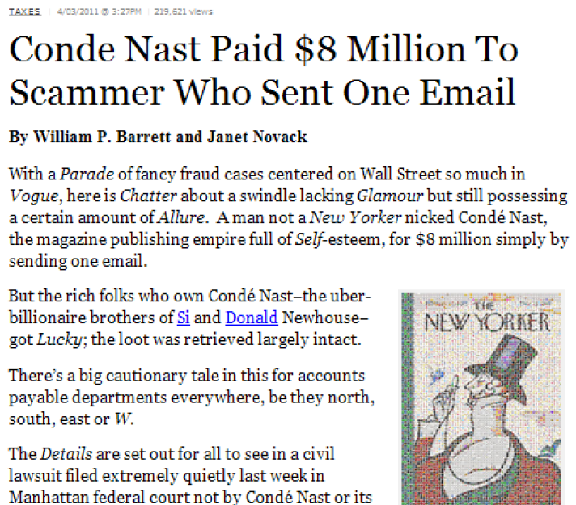

Slide 123
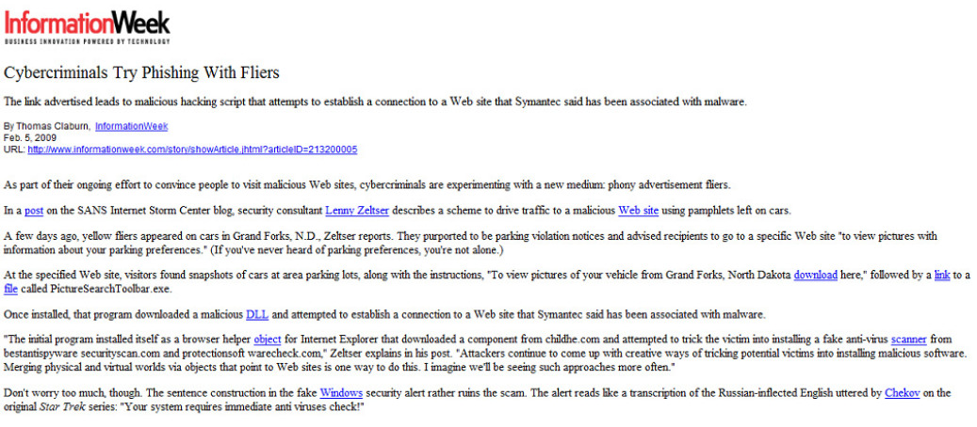

Slide 124
Scenario 1: quando utilizzarli?
L’esecuzione dei test di penetrazione per trovare falle nella azienda da attaccare, si è risolta in un nulla di fatto: non è stato trovato nessun metodo di attacco praticabile attraverso il perimetro della rete aziendale.
Le applicazioni web sono solide e non hanno apparenti vulnerabilità.
L'alternativa «zero-day» è l'unica opzione per ottenere l'accesso ai sistemi.

Slide 125
«Fuzzing»
Metodo di forza bruta alla caccia di bug.
Invia comandi casuali nella speranza di un incidente.
Esempio: se la lunghezza del buffer = 50 si invia 51

Slide 126
Precursor
Sono attacchi che si basano sul classico overflow
Ci sono diversi tipi di overflow e modi diversi per sfruttarli.

Slide 127
Buffer Overflow
Esempio: server SMTP suscettibile di uno stack overflow basato sul parametro "EHLO".
Inviando 6000 "\ x41" 's oppure ASCII =' A ‘ si scatena l’attacco.
Un attacker consapevole della vulnerabilità attraverso ulteriori ricerche è in grado di sfruttarla a proprio vantaggio.

Slide 128
Istruzioni di base da conoscere
JMP - Salta <indirizzo> (salto all'istruzione)
EIP - Instruction Pointer (indirizzo di ritorno)
ESP - Starter Pointer (inizio dello stack)
NOP - No operation (nessuna azione)

Slide 129
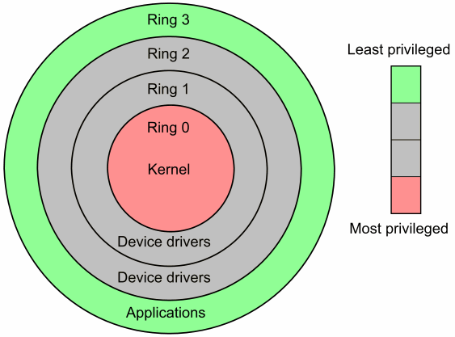
Organizzazione MS Windows

Slide 130
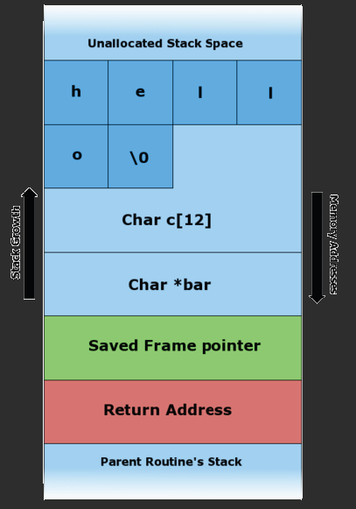
prima…

Slide 131
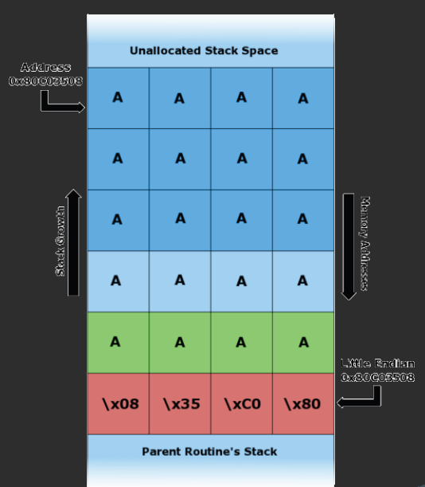
…dopo

Slide 132
Meccanismi di protezione
Data Execution Prevention : prevede che lo stack sia contrassegnato in sola lettura, con il conseguente fallimento dei tentativi di scrittura dello stack
Address Space Layout Randomization (ASLR): randomizza indirizzi di memoria da 2 byte

Slide 133
Address Space Layout Randomization (ASLR)
misura di protezione contro il buffer overrun e exploit che consiste nel rendere (parzialmente) casuale l'indirizzo delle funzioni di libreria e delle più importanti aree di memoria.
un attacco informatico che cerca di eseguire codice malevolo su un computer è costretto a cercare gli indirizzi del codice e dei dati che gli servono prima di poterli usare, provocando una serie di crash del programma vettore (infettato o apertamente malevolo).

Slide 134
Defeating Data Execution Prevention (DEP)
attacco return-to-libc, utilizza la Return Oriented Programming (POR).
Potrebbe eludere anche ASLR.
La funzione WriteProcessMemory() permette di bypassare DEP, consentendo di copiare lo shellcode maligno dallo stack ad un indirizzo di memoria scrivibile
ad esempio, un driver del kernel.
WriteProcessMemory() scrive dati da un'area di memoria in un processo specifico.

Slide 135
Protezione contro overflow
applicazioni closed-source di terze parti risultano essere tipicamente robuste.
un terzo processo maturo di revisione centrato sulla sicurezza delle applicazioni è comunque fondamentale.
il software sviluppato internamente deve essere sottoposto a rigorosi test per garantire una mitigazione dei probabili overflow prima di raggiungere la produzione.
un team dedicato alla ricerca degli zero-day attack.
Le minacce basate su questo tipo di attacchi devono essere rilevate prima ancora che si verifichino.

Slide 136
Minimizzare i danni di zero-day
Quando si utilizzano gli overflow, generalmente è necessaria la connessione.
Per inviare all’ attacker i dati ottenuti
Necessità di stretti filtri in uscita affinché i server possano connettersi solo a ciò che è assolutamente necessario su Internet sono indispensabili per far in modo che le informazioni non escano senza autorizzazione.

Slide 137
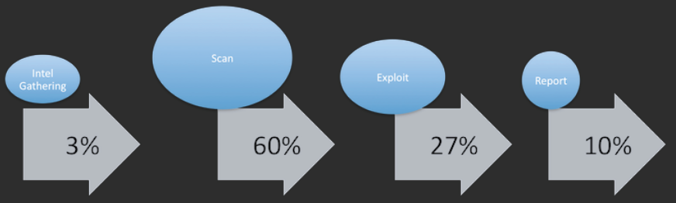
La fine dei PenTest tradizionali

Slide 138
Out of scope…
Le aziende non capiscono l’importanza di ciò che un vero test di penetrazione rappresenta.
Non esiste un framework aziendale solido adottato
Si ha solo una idea di massima dei rischi ai quali si è sottoposti, e poi il budget è sempre limitato
e poi da noi in azienda non è mai successo niente !

Slide 139
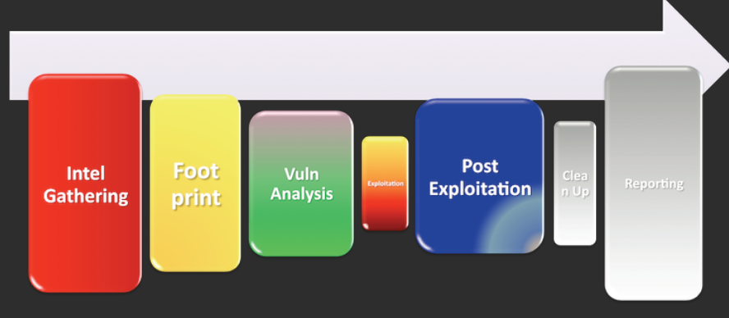
La giusta direzione

Slide 140
La giusta direzione
Se non ci si occupa di Ingegneria Sociale come parte integrante delle normali attività di penetration testing si è costantemente sull’orlo del baratro.
Dai rapporti SET si evince che il 94% delle infrastrutture testate è risultato vulnerabile ad uno o più attacchi effettuati con il toolkit SET

Slide 141
Misure di sicurezza fisiche
Intrusion Detection / Prevention
Allarmi, Videosorveglianza
Controllo Accessi
Serrature, controllo delle visite

Slide 142
Video Sorveglianza
una delle più longeve misure di sicurezza fisica disponibile
Spesso in esecuzione sulla stessa rete IP come le altre applicazioni
Deve essere configurata in modo sicuro
Monitoraggio in tempo reale
Il posizionamento è fondamentale
Posizionate in tutti gli ingressi, nelle aree di lavoro, all'interno e all'esterno dei datacenter

Slide 143
Allarmi
perimetrale e interno
possono essere posizionati una serie di sensori
che rilevano diversi parametri
collegato con le forze dell’ ordine
i codici di allarme devono essere univoci per ogni dipendente
controllo dell’accesso su scala individuale
l 'accesso è limitato tramite autenticazione

Slide 144
Controllo degli accessi
Una revisione dell’accesso dovrebbe avvenire regolarmente
Sicurezza multilivello
Discutere le opzioni con il fornitore della soluzione tecnologica

Slide 145
Radio Frequency ID Cloning (RFID)
3 livelli di frequenza
Bassa (LF) clonato entro 3 ft
Alta (HF) clonato entro 3-10 ft
Ultra-High (UHF) clonato entro 30 ft
La maggior parte dei sistemi di controllo di accesso utilizza la bassa frequenza passiva

Slide 146
Serrature
Virtualmente qualsiasi serratura classica con la chiave può essere aperta
Necessità di un inventario delle chiavi
Le serrature elettroniche sono le migliori
I codici di accesso dovrebbe essere univoci per ogni dipendente
L'accesso è gestito centralmente

Slide 147
Controllo dei visitatori
guardie
gli occhi umani sono spesso meglio di quelli elettronici
visitatori annunciati e scortati
registro dei visitatori
accesso preferibilmente automatizzato
implementare controlli specifici per i visitatori esterni

Slide 148
Controllare i documenti
la consapevolezza dei dipendenti del controllo come pratica da attuare ogni giorno
sicurezza dell’ area deposito documenti
raccogliere i brandelli di documenti sul posto
non lasciarli vicino al tritacarte
prevedere un certificato di distruzione
pratica della scrivania libera (clean desk policy)

Slide 149
Una nuova cultura
La sicurezza a più livelli è decisamente più efficace
affronta il problema da diversi punti di vista
La sicurezza è una cultura
convalidare la sicurezza
La chiave è la sensibilizzazione alla sicurezza

Slide 150
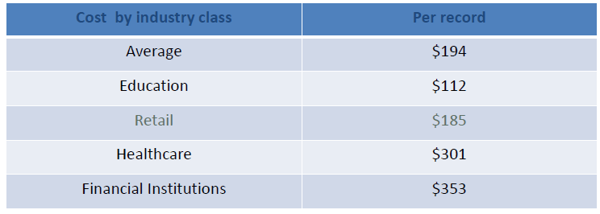
Quanto costa una perdita di dati?
Sintesi del report redatto dal Ponemon Institute nel 2012 sul costo annuale di una violazione di dati:
I costi diretti sono stimati in $ 59 per violazione.
Spese per il consulente legale, lettere di notifica, monitoraggio del credito, ecc
Il driver principale risultano essere i costi legali di difesa.

Slide 151
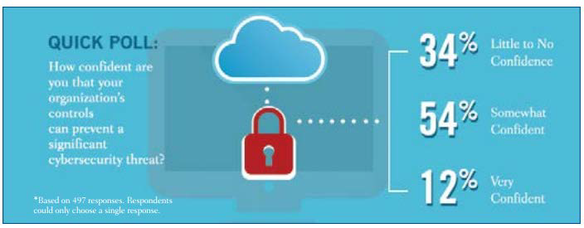
Le organizzazioni sono preparate?
sorgente: IIA Tone at the Top; April 2014

Slide 152
Cosa proteggere ?
Identificazione asset:
Basi di dati
File
Server
Applicazioni
Hardware
siti web
Classificazione asset:
Posizione
Proprietario
Uso
Tipo
stato
livello di rischio

Slide 153
Classificare i dati in base alla prevenzione dei rischi
dati riservati
I dati devono essere classificati come riservati quando la divulgazione non autorizzata, alterazione o distruzione di tali dati potrebbe causare un significativo livello di rischio.
Esempi: numeri di carte di credito, numeri di previdenza sociale
i dati privati
I dati devono essere classificati come privati quando la divulgazione non autorizzata, alterazione o distruzione di tali dati potrebbe comportare un livello di rischio moderato.
Esempi: Indirizzi, nomi di dipendenti
dati pubblici
I dati devono essere classificati come pubblici quando la divulgazione non autorizzata, alterazione o distruzione di tali dati costituisce un minimo o nessun rischio.

Slide 154
Valutare il rischio
Identificare i rischi
Assegnare un ranking al rischio
Determinare la tolleranza al rischio
Identificare le minacce esterne e interne, e distinguere tra loro
Identificare modifiche recenti/ in corso nel contesto operativo
potrebbero introdurre ulteriori rischi

Slide 155
valutazione dei rischi: errori comuni
Non comprendere l'ambiente operativo e l’infrastruttura IT
Sottovalutare la complessità delle minacce di sicurezza informatica
Non assegnare tempo sufficiente per una revisione globale
Considerare elevato il livello di conoscenza / competenza degli Ingegneri Sociali (prendendoli in parola)

Slide 156
Con l'aiuto di professionisti della sicurezza
Vantaggi di utilizzare specialisti esterni
Costo
Perizia accurata
Indipendenza
Benchmarking rispetto ad altre organizzazioni
Valutare la capacità degli specialisti
Certificazioni
Esperienza
Riferimenti

Slide 157
Adottare un framework
ISO 27000
Cybersecurity Capability Maturity Model (C2M2)
settore elettronico (ES-C2M2)
settore gaspretolifero (ONG-C2M2)
National Institute of Standards and Technology (NIST)
Cybersecurity Framework
Iniziativa Nazionale per Cybersecurity Education (NICE)
Capability Maturity Model (CMM)

Slide 158
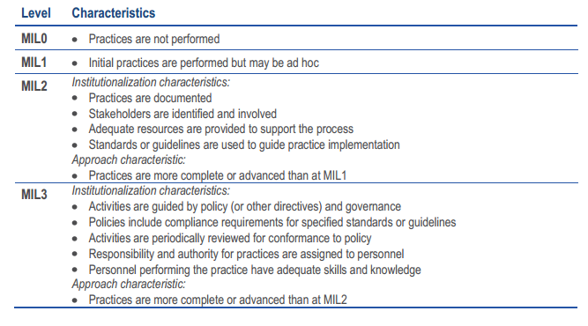
C2M2 Maturity Levels

Slide 159
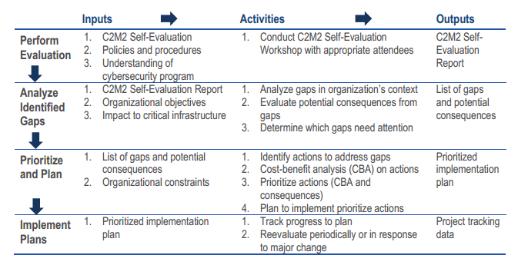
C2M2 – Approccio Raccomandato

Slide 160
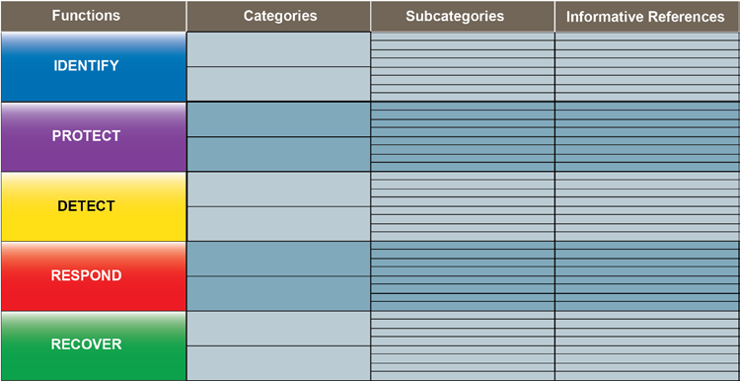
Obiettivi del Framework NIST

Slide 161
Obiettivi del Framework NIST
Identificazione
Gestione Delle Risorse
Governance
Valutazione Del Rischio
Protezioni
ITGCs (Access Control)
Sensibilizzazione e Formazione
Sicurezza dei dati
Informazione / Asset Protection
Manutenzione
Tecnologia di protezione
Individuazione
Monitoraggio

Slide 162
Obiettivi del Framework NIST
Risposta
pianificazione
comunicazione
analisi
mitigazione
Recupero
miglioramento

Slide 163
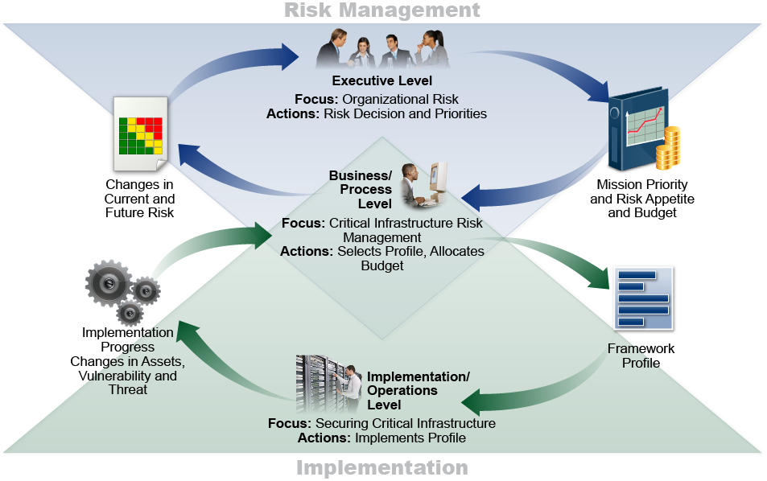
Implementazione del framework NIST

Slide 164
Stabilire obiettivi e dei relativi controlli
L’ approccio preferito è quello basato sul rischio
Indagare le vulnerabilità esistenti
minacce reali o sospette
informazioni in secondo piano
affrontare tutti i rischi e gli scenari individuati
Priorità sulla base della classificazione dei dati
Miglior alleato della governance

Slide 165
Allineare i controlli con gli obiettivi
Obiettivo della CyberSecurity | Controllo
Gli attacchi e violazioni siano identificati e trattati in modo tempestivo e appropriato. | Software di monitoraggio in vigore su tutti i server.
 | Le notifiche vengono inviate quando viene rilevata qualsiasi attività sospetta.
 | Le notifiche vengono registrate con una priorità e sono soddisfatte secondo l’ ordine stabilito.

Slide 166
Controlli tipici di sicurezza di rete
politica della sicurezza
schema della rete
rilevamento delle intrusioni e firewall / prevenzione
DMZ
Anti-virus / minacce
Scansione delle vulnerabilità e della penetrazione dei test eseguiti
Monitoraggio continuo

Slide 167
Controlli tipici di sicurezza di rete
Limitare l'accesso remoto
Applicare politiche per le password
filtraggio dei contenuti
La formazione dei dipendenti
Log di accesso utente
crittografia
Monitorare e valutare i servizi di terze parti ai quali si accede

Slide 168
Utilizzare i framework come guida
Council on Cybersecurity: Top 20 Critical Security Controls (v5)
Area | Critical Security Control
Gestione del patrimonio | 1. Inventario dei dispositivi autorizzati e non autorizzati 2. Inventario dei software autorizzati e non autorizzati
Monitoraggio e risposta | 3. Manutenzione, monitoraggio e analisi dei log di audit 4. Risposta ad un incidente e gestione della criticità

Slide 169
Utilizzare i framework come guida
Area | Critical Security Control
Wireless/BYOD | 5. Controllo device wireless
Logical Access | 6. Limitazione e controllo della rete, porte, protocolli e servizi. 7. Uso controllato dei privilegi amministrativi 8. Accesso controllato basato sulla necessità di sapere. 9. Monitoraggio e Controllo degli account
progettazione della rete | Difesa dei confini della rete Secure Network Engineering

Slide 170
Utilizzare i framework come guida
Area | Critical Security Control
Server & Device | 12. Configurazioni sicure per hardware e software sui dispositivi mobili, computer portatili, workstation e server 13. Configurazioni sicure per i dispositivi della rete, quali firewall, router, switch
Risorse Umane | 14. formazione adeguata e continua anche con rilascio di certificazioni riconosciute nell’ ambito
Vulnerability and Pen Testing | Vulnerability Assessment and Remediation Penetration Test

Slide 171
Utilizzare i framework come guida
Area | Critical Security Control
Sicurezza Applicativa | Difesa dai Malware Sicurezza Software a livello applicativo
Gestione dei dati | 19. Recupero dei dati 20. Protezione dei dati

Slide 172
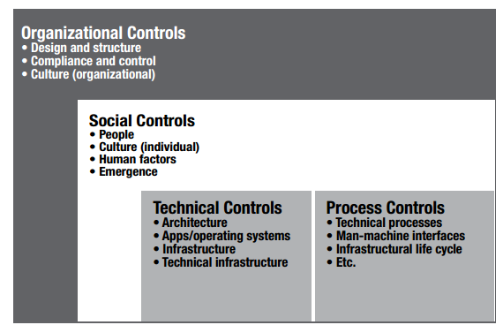
Classificare i controlli in base al tipo di rischio
Sorgente: ISACA

Slide 173
Efficacia test ambientali
Audit
Accesso logico
Backup / Recovery
Monitoraggio
Audit del Firewall
Revisione configurazione della rete
Social Engineering e Phishing Assessment
Vulnerabilità e Penetration Test

Slide 174
Strumenti utili
Netcraft.com
NMAP
Nipper
Scanner di vulnerabilità
PCAT
Nessus
NeXpose
OpenVAS
Penetration Test
Metasploit
w3af
Nist.gov
National Vulnerability Database

Slide 175
Identificare / Riparare vulnerabilità
convalidare i risultati con l’ Ingegnere Sociale
assegnare una valutazione al rischio
sviluppare un piano di bonifica con l’ IS
stabilire un piano d'azione
assegnare responsabilità
aggiornamento della documentazione / comunicazione (se necessario)
aggiornare il management su quanto fatto

Slide 176
Monitoraggio / Aggiornamento
valutare l’Ingegneria Sociale nei piani d'azione strategici per l’azienda
comunicare le deviazioni dai piani di azione con il management
Monitorare attività esistenti che possono influenzare i piani d'azione o introdurre nuovi rischi non contemplati
Necessario il monitoraggio continuo anche per garantire tempi comunicazione e di risposta rapidi

Slide 177
Raccomandazioni finali
Educare e coinvolgere tutti i livelli dell'organizzazione
Integrare una strategia di rischio nel piano strategico dell'organizzazione
Avere un team dedicato alla gestione delle minacce informatiche
Automatizzare il più possibile
Collaborare internamente ed esternamente

Slide 178
ChatBot
Personalization became an important business strategy in Business to Consumer commerce
Recommender systems have become integral to e-commerce
A chatterbot (chatbot) system is a software program that interacts with users using natural language

Slide 179
ALICE
A.L.I.C.E. is an artificial intelligence natural language chat robot based on an experiment specified by Alan M. Turing in 1950
A.L.I.C.E. bot has at present more than 40,000 categories of knowledge
A.L.I.C.E. won the Loebner Prize, an annual Turing Test, in 2000 and 2001.
ALICEbots could be given an ‘expert appearance’ within a particular domain of knowledge

Slide 180
Categories
<category>
<pattern>HI</pattern>
<template> Hello, nice to meet you. </template>
</category>
symbolic reduction can be used to “jump” from one category to another
Atomic categories: are those with patterns that do not have wildcard symbols, _ and *, e.g.:
<category>
<pattern>10 Dollars</ pattern>
<template>Wow, that is cheap. </ template>

Slide 181
Reductions…
Default categories: are those with patterns having wildcard symbols * or _.
<category>
<pattern>10 *</pattern>
<template>It is ten.</template>
</category>
Recursive categories: are those with templates having <srai> and <sr> tags, which refer to recursive reduction rules.

Slide 182
…reduction…
c.1 Symbolic reduction
<category>
<pattern> DO YOU KNOW WHAT THE * IS </pattern>
<template>
<srai> What is <star/× /srai>
<template>
</category>

Slide 183
…Reduction…
c.2 Divide and conquer
<category>
<pattern> YES *</pattern>
<template>
<srai> YES</srai>
<SR/>
<template>
</category>

Slide 184
…Reduction
c.3 Synonyms
<category>
<pattern> HALO</pattern>
<template>
<srai> Hello< /srai>
<template>
</category>

Slide 185
Normalization
: “I do not know. Do you, or will you, have a robots.txt file?”
Then after the normalization it will be: “DO YOU OR WILL YOU HAVE A ROBOTS DOT TXT FILE”.
Graphmaster/nodemappers
There are more than 50,000 categories in the current public-domain ALICE “brain”
all these categories are manually “hand –coded”

Slide 186
Chatbot applications
A number of chat robots have been developed to serve different application domains.
Education, training, commerce, entertainment
ELIZA was developed to serve as a psychoanalyst who simply frames questions deriving from the user input itself
Memoryless
EGAIN CHATBOT and IKEA [IEKA.com] are help center chatbot
YPA is a natural language Chatbot dialogue systems that allows user to retrieve information British Telecom’s Yellow pages

Slide 187
Dialogue systems
The simplest dialogue managers are based on finite-state automata
states -> questions
arcs -> actions (depending on a user-provided response)
fixed- or system-initiative conversations
true mixed-initiative systems allow either dialogue participant to contribute to the interaction as their knowledge permits

Slide 188
Natural language assistant
Natural Language Assistant [NLA] allows customers to make requests in natural language and directs them towards appropriate web pages
A natural language search with the user specification can be formulated “The fastest Computer under $1400”.
The Adative Place Advisor suggested by [Cynthia A. T., Goker H. M. and Pat L] presented a novel user model that influences both item search and the questions asked during a conversation

Slide 189
Knowledge acquisition with Alice
The process of knowledge acquisition is to transfer existing knowledge and its structure into a computer-interpretable form
One of the approaches is Eliza-type chatter bot, which played the role of a Rogerian psychotherapist to pseudo extract information from its patients
With Eliza, it became possible to carry on generalized conversations in a reasonable manner.

Slide 190
Natural Language Toolkit
The Natural Language ToolKit (NLTK) is a set of modules, tutorials and exercises which are open source and cover Natural Language Processing symbolically and statistically.

Slide 191
Parts of a Chatbot
Responder:
interfacing between the bot’s main routines and the user.
transferring the data from the user to the Classifier
controlling the input and output.
Classifier:
between the Responder and the Graphmaster.
filtering and normalising the input,
segmenting the input entered by the user into logical components,
transferring the normalised sentence into the Graphmaster,
processing the output from the Graphmaster, and
handling the instructions of the database syntax (e.g. AIML).
Graphmaster:
pattern matching
organising the brain’s contents,
storage and holding the pattern matching algorithms.

Slide 192
Chatbot techniques…
Parsing
Pattern Matching
Aiml
Chat Script
SQL and Relational Database
Markov Chain
Language Tricks
Ontologies

Slide 193
… Chatbot techniques…
SQL:
a database that saves the conversation history in order to make a search for any word or phrase match easier.
Speech analysis and response:
voice recognition and conversion to text,
text processing, and
response and action taking.
The input to this Chatbot is keywords released from the speech text processing;
the output is the programmed response.

Slide 194
Malversiting…
June was the worst month ever for malvertising, said Patrick Belcher, Director of Security Analytics for Invincea.
Yahoo! was hit in July by one of the largest malvertising attacks ever seen, said Jerome Segura, Malwarebytes’ Senior Security Researcher.
Malcious ads spiked 260% in the first quarter of 2015 compared to the same period last year, according to RiskIQ.

Slide 195
…Malversiting…
Malvertising is the use of online ads to spread malware.
Drive by download
requires no interaction from the user.
Infection begins once the user visits a site and the malicious ad is loaded.
The user’s system is penetrated through software vulnerabilities found in common applications such as Flash and Java.
Redirects
the user clicks an ad and is redirected to a malicious site that installs malware on the system.
Fake viruses and updates

Slide 196
The Payload
Ransomware typically encrypts a victim’s files and demands a ransom to unlock them.
Click-fraud malware secretly clicks ads to defraud advertisers and generate income for the attacker.
Adobe Flash is the application most targeted by today’s malvertising attacks.
Several zero-day exploits
Pros
Many users
Buying ads is typically cheap, anonymous, and automated.
Profiling target

Slide 197
Malvertising ecosystem
The internet economy runs on advertising. Without ad revenue, many websites would not exist.
By joining an ad network, websites can easily turn site traffic into revenue.
the site owners have no control over the ads’ content.
Major ad networks serve billions of ads a day. Uncovering the tiny percentage that are harmful is a major task.

Slide 198
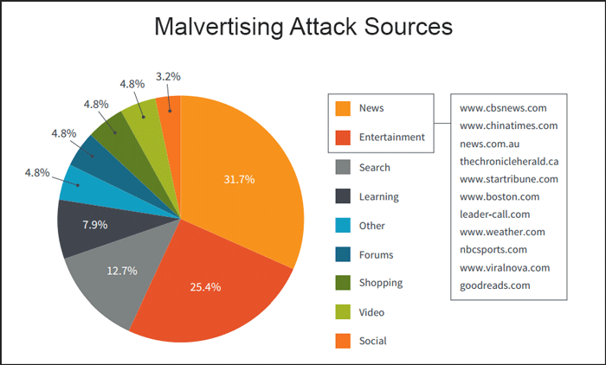

Slide 199
Evasion
The combination of a drive-by download with a zero-day attack for an application as widespread as Flash is a frightening prospect.
Attackers are improving how they side-step detection by anti-virus and intrusion detection systems.
A growing trend is for malware to build and install itself in a series of steps, rather than loading and installing a full package.

Slide 200
How to fight malvertising
70 percent: is the estimated amount of malvertising campaigns that deliver ransomware as a payload.
Malware typically requires administrator-level access to install.
Disable Flash
Disable java
Block ads with plugins
Filter Websites

Slide 201
OSINT
Only the Paranoid will Survive

Slide 202
Intelligence Gathering
Open-Source Intelligence (OSINT) refers to a broad array of information and sources that are generally available, including information obtained from
the media (newspapers, radio, television, etc.),
professional and academic records (papers, conferences, professional associations, etc.), and
public data (government reports, demographics, hearings, speeches, etc.).
Cit. Fbi.gov

Slide 203
Int-something
GEOINT
SIGINT
TECHINT
FININT
HUMINT

Slide 204
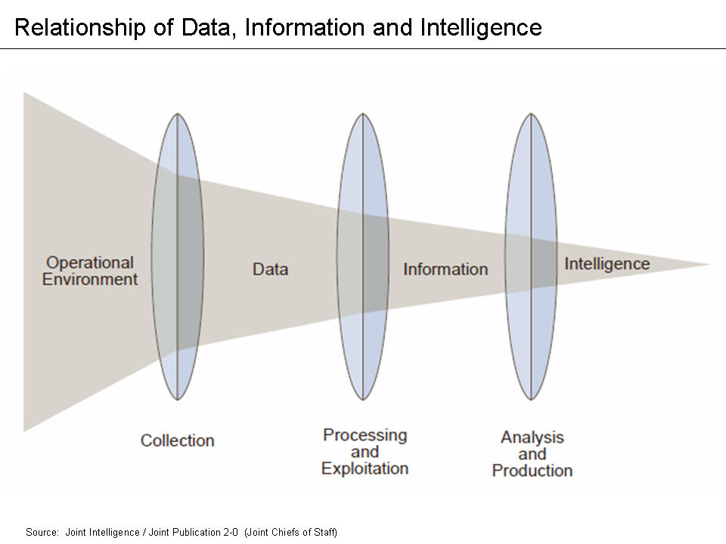
The Intelligence Gathering Process

Slide 205
Who collects and uses Intelligence
Law Enforcment
Military
Criminals
Spies
Government
Journalists
Business
Hackers

Slide 206
Before we start......
I veggenti del terzo millennio

Slide 207
Some Interesting tools of Mass Surveillance
Recorderded Future
Palantir
Gemalto
Prism

Slide 208
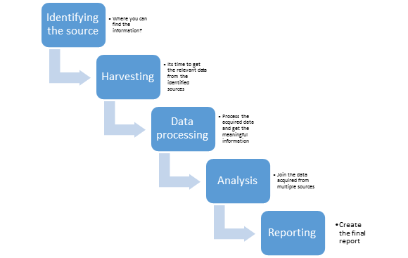
The OSINT Process
Hostname
Services
Networks
SW/HW versions and OS information
Geo-location
Network diagram
Database
Documents, papers, presentations, spreadsheets and configuration files
Metadata
Email and employee search (name and other personal information)
► Technology infrastructure
► IP

Slide 209
DNS Intelligence
Dig for DNS information
Cache snooping
Zone transfer
Reverse lookup bruteforce
Wildcard entries
Fierce,dnsenum,dnsrecon,subroute
IP to ASN
https://www.robtex.com/
A (IP address)
SOA (Start of Authority)
CNAME (canonical name)
MX (mail exchange)
SRV (service)
PTR (pointer)
NS (name server)
axfr

Slide 210
Doxing
Is the Internet-based practice of researching and broadcasting private or identifiable information (especially personally identifiable information) about an individual or organization
Google
Bing
Peek you
Pipl
Intelius
Facebook GRAPH
Shodan
Opentopia.com
Name
Ages
Email
Addresses
Phone numbers
Photos
Etc.
Location
IP CAMERA & IoT!!!

Slide 211
Google advanced operators
Web Search: allinanchor:, allintext:, allintitle:, allinurl:, cache:, define:, filetype:, id:, inanchor:, info:, intext:, intitle:, inurl:, link:, related:, site:
Image Search: allintitle:, allinurl:, filetype:, inurl:, intitle:, site:
Groups: allintext:, allintitle:, author:, group:, insubject:, intext:, intitle:
Directory: allintext:, allintitle:, allinurl:, ext:, filetype:, intext:, intitle:, inurl:
News: allintext:, allintitle:, allinurl:, intext:, intitle:, inurl:, location:, source:
Product Search: allintext:, allintitle:

Slide 212
personally identifiable information
Website investigation:
https://Pipl.com
http://www.amazon.com/gp/registry/search/
http://www.indeed.com/resumes?q=%22PHm%22
https://www.linkedin.com/vsearch/f?trk=federated_advs&adv=true
Cached data: http://archive.org/web/, google cache,
Knowem,
checkusernames.com/
https://namechk.com/

Slide 213
Personally identifiable information
US only:
http://www.classmates.com/
https://www.intelius.com/
http://radaris.com/
http://www.spokeo.com/
http://www.peekyou.com/
http://mugshots.com/

Slide 214
Personally identifiable information
Bitcoin :
https://blockchain.info/address/1Kqzbv4ekpJX3ohYWGEzMqzvf27VjBux35
https://www.blockseer.com/addresses/1Kqzbv4ekpJX3ohYWGEzMqzvf27VjBux35
Skype :
http://www.skresolver.com/
Companies/ business :
https://findthecompany.com
http://copyright.gov/
http://www.keywordspy.com/
https://www.crunchbase.com
https://connect.data.com

Slide 215
Geo-Location
Gmaps
Gearth
Private earth observation satellites:
GeoEye – 5 satellites: IKONOS, OrbView-2, OrbView-3, GeoEye-1, GeoEye-2
DigitalGlobe – 4 satellites: Early Bird 1, Quickbird, WorldView-1, Worldview-2
Spot Image – 2 satellites: Spot 4, Spot 5

Slide 216
SOCMINT
FacebookGRAPH
Fbsleep
Creepy
http://www.socialmention.com

Slide 217
Reverse Image Search
Google Image
Tineye
Yandex
Googles (on G Play Store)
Findface (on G Play Store)

Slide 218
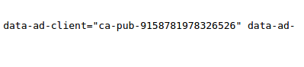
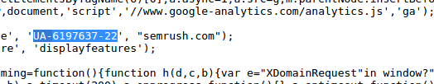
Ad Analytics
http://spyonweb.com/
http://sameid.net/
https://ewhois.com

Slide 219
Whois intelligence
Domain related information
Personal information
Contact details
Domaintools
The registry – Stemming from ICANN, branching bodies manage top level domains (tld) such as com and org
The registrar – Where we purchase our domain names
The registrant – The purchaser of the domain

Slide 220
Metadata | 'data about data'
Foca
Metagoofil
Exiftool <exif foto e docs>
http://www.motherjones.com/files/images/war_photo_063010.jpg
gpg –- with-fingerprint key.asc
Printers SRSLY?????

Slide 222
https://www.veracode.com/blog/2013/03/hacking-the-mind-how-why-social-engineering-works

Slide 223
References
Responding to Cybersecurity and Social Engineering Threats , 2015 OTA Winter Conference and Trade Show
Physical Security to mitigate Social Engineering Risks, http://www.claconnect.com/
Guide to Preventing Social Engineering Fraud, http://www.chubb.com/
Defensive Training for Social Engineering, 22nd Annual Conference, FISSEA 2009

Slide 224
References
Chris Hadnagy (loganWHD) , http://www.social-engineer.org
SEcManiac, Hacking your perimeter..., http://www.secmaniac.com
Case Study Of Industrial Espionage Through Social Engineering, http://csrc.nist.gov/nissc/1996/papers/NISSC96/paper040/WINKLER.PDF, NIST
SANS, http://www.sans.org/reading-room/catindex.php?cat_id=51

